Slide 1
LO: Solve absolute value equations and inequalities SLE: Meet or exceed CCSS
How to solve Absolute value equations/inequalities:
Equations:
1. Isolate the absolute value expression:
|x| + 4 = 18
|x| = 14
2. Solve for the positive and negative value of the absolute value expression:
X = 14, -14
Example:
-3|x -2| = -48
|x-2| = 16
X-2 = 16 x-2 = -16
X = 18 x = -14
X = 18, -14

Slide 2
Inequalities:
Solving inequalities is the same as for equations. However, be sure to flip the inequality symbol when solving for the negative value:
|2x + 4| > 16
2x + 4 > 16 or 2x + 4 < -16
2x > 12 or 2x < -20
X > 6 or x < -10

Slide 3
Practice Problems:
1.) 4 – 3|m + 2| > -14
2.) |x| + ½ = 3 ½
3.) |4x – 5| = 2x + 1
4.) A pasta company makes 400g boxes of microwave pasta. The allowable error when filling the boxes at the factory is + 0.5g. Write an absolute value inequality that represents this situation. Then solve it.

Slide 4
LO: Solve absolute value equations/inequalities SLE: Meet or exceed CCSS
Homework:
1. Complete the second absolute value equations worksheet. On page 1, do all of the problems. On page 2, do just the even numbered problems.

Slide 5
Good Morning!
Solve: -1|2x – 8| = - 3
2 4
2. Graph: y = x² – 3
3. You have three dice. What is the probability of rolling three sixes?

Slide 6
Good morning:
On a coordinate plane, what is the distance between (2,5) and ( -4, 2)?
Write the equation of a line that passes through (2,4) and has a slope of -1/2.
A cylinder is 9cm wide and 30cm tall. What is the surface area of the cylinder?
A square painting is placed in a 3cm-wide frame. Including the frame, the area of the picture is 600cm squared. What is the area of the picture?

Slide 7
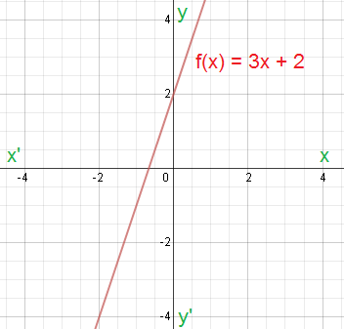
LO: Find the slope of linear functions. SLE: Meet or exceed CCSS
What is a function?
A function shows the relationship between two variables. Functions are commonly expressed as an equation (called a function, oddly enough) or a line on the coordinate plane. Sometimes they’re expressed as tables, but this is not common, because it’s completely lacking in elegance, and is actually quite irritating.

Slide 8
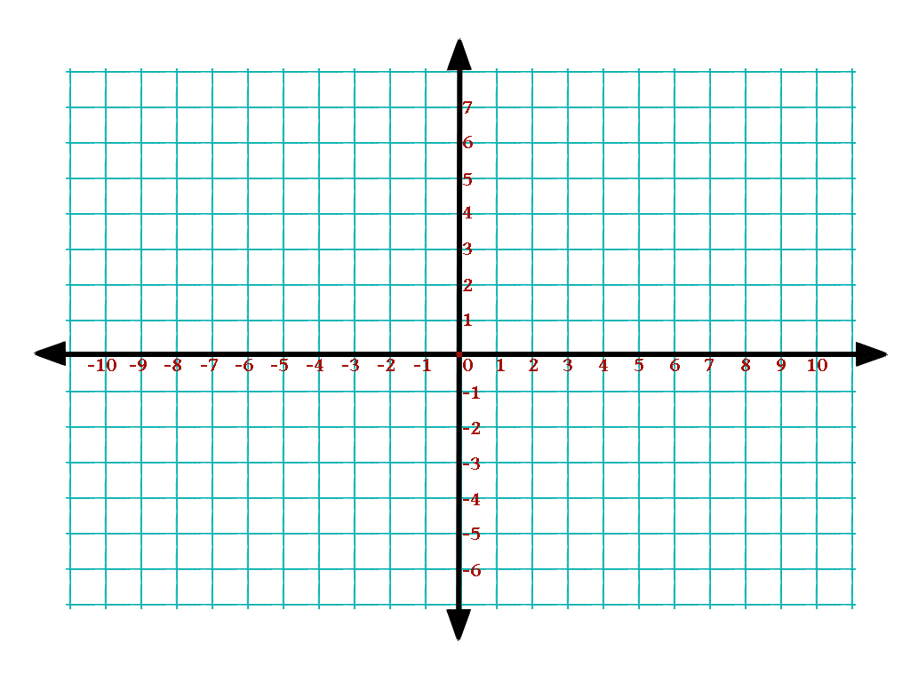
Use this table to write a function, and graph it on the coordinate plane:
X: | F(x):
-2 | -3
-1 | -1
0 | 1
1 | 3
2 | 5

Slide 9
How to find the slope using a table:
Find the rate of change in the y or f(x) values.
Find the rate of change in the x values.
Divide: Change in y values
Change in x values

Slide 10
Example:
Time (hours) | Temperature ( c )
1 | -2
4 | 7
7 | 16
10 | 25
13 | 34
Temperature is a f(x), since it depends on time.
Time is the x value.
Change in the temperature rate:
Change in the time:
Temperature/time =

Slide 11
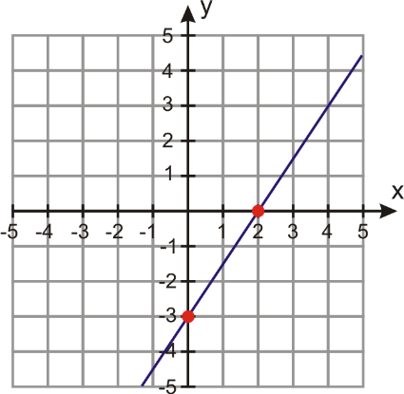
Finding slope from graphs:
Find two points on the line, and divide the difference in y coordinates by the difference in x coordinates:
y₁ - y₂
x₁ - x₂

Slide 12
Finding slope from functions:
Look at the coefficient of x:
y = -3x + 2
Finding slope with two points:
Again, it’s : y₁ - y₂
x₁ - x₂

Slide 13
Example:
Find the slope of a line that passes through (1,5) and (4,2):
5 -2
1 -4 = - 3/3 = -1

Slide 14
Zero and undefined slope:
The slope of a line that passes through (2, 4) and (2, 1) is 4 -1/ 2-2 = 3/0. 3/0 is undefined, and so is the slope.
The slope of a line that passes through (3, 4) and (5,4) is 0/-2, or 0. The slope of this flat line is zero.

Slide 15
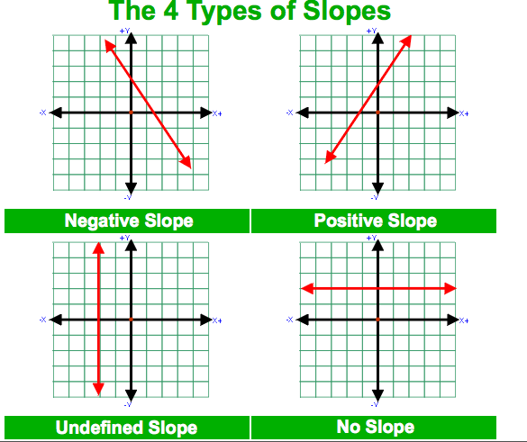

Slide 16
Practice Problems:
Find the slope of a line that passes through (-2, 1) and (6,7)
What is the slope of y = -2x + 16 ?
Find the slope of a line that passes through (2, 4) and 2, -5)
Graph this function:
y = -2

Slide 17
Homework:
LO: Find the slope of linear functions
SLE: Meet or exceed CCSS
p. 312- 313, #2- 38 even. Use graph paper, please.

Slide 18
Good Morning!
5|2x – 4| > 5
-12 > 4x – 8 > 2
Sarah and John leave school traveling in opposite directions on a straight road. Sarah drives 12 km/h faster than John. After 2 hours, they are 176 km apart. What are their speeds?

Slide 19
LO: Graph and write functions in standard form SLE: Meet or exceed CCSS
Forms of linear functions:
Slope-intercept form: y = 2x + 1
Point slope form: y – 3 = 2(x – 1)
Standard form: 2x – y = 6

Slide 20
Finding x and y intercepts:
An intercept is the point at which a line crosses the x or y axis. To find the x intercept, substitute 0 for y and solve for x:
3x + 4y = 12
3x + 4(0) = 12
3x = 12
X = 4; the x intercept is 4, i.e., the line crosses the x axis at (4, 0)

Slide 21
Graphing using x and y intercepts:
Find the x and y intercepts.
Plot those intercepts
Connect the points
3x + 7y = 21
3x = 21 7y = 21
X = 7 y = 3

Slide 22
Transforming to standard form:
Standard form doesn’t use fractions:
y = 3/4x + 2
4y = 4(3/4x + 2)
4y = 3x + 8
-3x + 4y = 8

Slide 23
Practice:
Graph using x and y intercepts: 5x + 2y = -10
Graph y = 3
Graph x = 5
Graph uing x and y intercepts: -4x + y = 2
Transform to standard form: y = -2/5x + 1
Transform to standard form: y = 3x + 1

Slide 24
Homework:
LO: Write and graph linear equations in standard form
SLE: Meet or exceed CCSS
p. 333 #2-36 even

Slide 25
Good Morning:
Find the equation of a line that passes through (2,3) and (-1, 5).
Write the equation in #1 in standard form.
Graph the equation in #2 using x and y intercepts.

Slide 26
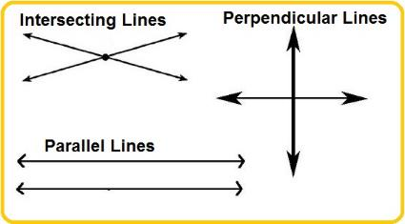
LO: Write, graph parallel and perpendicular linear equations SLE: Meet or exceed CCSS
Parallel vs. Perpendicular Lines:
Parallel lines never intersect
Perpendicular lines intersect each other at a 90º angle.

Slide 27
Slope of Parallel & Perpendicular Lines:
Parallel lines always have the same slope:
y = 2x + 3 and y = 2x – 7 are parallel because for each, m= 2.
Perpendicular lines have slopes that are the opposite inverse of each other:
y = 2x + 2 and y = -1/2x + 3 are perpendicular because
2 * -1/2 = -1

Slide 28
Writing equations of parallel lines:
Write a line parallel to
y = 2x + 1 that passes through (4, 5):
Find the slope: m = 2
Find the y intercept of the line that passes through the given point:
y = mx + B → 5= 2(4) + b →5 = 8 + b → - 3 = b; the y intercept is -3.
Write the new equation: y = 2x – 3

Slide 29
Writing equations of perpendicular lines:
Write an equation of a line that is perpendicular to y = x + 3 that passes through (4, 3).
Find the slope of the perpendicular line:
m = -1
Find the y intercept of the new line:
y = mx + b → 3 = -1(4) + b →
3 = 2 + b → b = 1. The y intercept is 1.
Write the equation of the new line:
y = -1/2x + 1

Slide 30
Practice Problems:
Find the slope of a line perpendicular to
y = -3x + 4
Write the equation of a line that is parallel to y = 2x + 3 and passes through (1, 4)
Write the equation of a line that is perpendicular to y = x + 2 that passes through (4,6)
Find the equation for a line that is perpendicular to x = 2 and passes through (3,4)

Slide 31
LO: Write equations of parallel and perpendicular equations SLE: Meet or exceed CCSS
Homework:
p. 346 #2-46 even
Don’t forget about the inequalities quiz tomorrow!

Slide 32
Good Morning:
You have a quiz today, so there are no warm-up questions this morning.
☺

Slide 33
More Practice Problems:
Write the equation of a line that is parallel to y = 6x - 2 and passes through (0, 0). (In slope-intercept form)
Write the equation of a line perpendicular to 4x – 2y = 9 that passes through (8, -2)
Is 2x + y = 2 parallel to y = -2x + 2? Why or why not?

Slide 34
Good morning:
1. Write the equation of a line perpendicular to y = 3x – 3 that passes through (1,2).
2. A cube has a volume of 125 cm³. What is the surface area of the cube?
3. Solve: 2x – 3 = 4x + 1
5 6

Slide 35
LO: Graph & write absolute value equations SLE: Meet or exceed CCSS
Graph this absolute value equation:
Y = |x|
x | y
-2
-1
0
1
2

Slide 36
Vertical translations:
A translation is a shift of a graph vertically, horizontally, or both.
Vertical translations look like this:
y = |x| + 4
Y = |X| - 2

Slide 37
Horizontal translations are trickier:
y = |x + 4| translates the graph four units to the left;
y = |x - 4| translates the graph four units to the right.

Slide 38
What is the equation for this absolute value graph?
What does the graph of
y = -|x +1| look like?

Slide 39
Practice problems:
Write the equation for the graph to the right.
Draw a graph for
y = |x + 2| - 1
3. What is the equation for a graph that translates 1 unit down and 3 units to the left?

Slide 40
Homework (you’re welcome ☺):
LO: Write and graph absolute value equations
SLE: Meet or exceed CCSS
- p. 361-362 #2- 40 even

Slide 41
Good morning:
1. Draw a graph for
y = |x + 2| - 1
A cheetah can run 50mph (124km/h). How many m/s is that?
You kayak down a stream. Your speed through the water is 5km/h. The current runs at 2km/h. How long will it take you to paddle to the grocery store 20km downstream, and then return with supplies?

Slide 42
LO: Solve compound inequalities and absolute value equations SLE: Meet or exceed CCSS
Compound inequalities are inequalities that show a range of possible solutions between two values or outside a range of values:
Between two values (“and”):
-4<x<0
Outside the range of two values (“or”):
x< -2 or x > 5

Slide 43
Solving absolute value equations:
Absolute value expressions, as the name suggests, show the absolute value of a variable or of an expression (or the distance from zero on a number line).
|x| = 6

Slide 44
Solving absolute value equations:
Step 1: isolate the absolute value expression or variable:
|x + 2| + 4 = 8
|x + 2| = 4
Step 2: Solve for positive and negative values:
X +2 = 4; x + 2 = -4
X = 2, -6

Slide 45
Solving absolute value inequalities:
Be sure to flip the sign for the negative value!
|x – 3| > 4
X-3 > 4 or x-3 < -4
X > 7 or x < -1

Slide 46
Practice problems:
1.) |-3n| - 2 = 7
2.) 4- 3|m + 2| > -14
3.) |a| + 0.5 > 3.5
4.) -2|2x + 7| = 12

Slide 47
Good Morning:
1.) Solve: 6|2x – 4| > 24
2.) A 2m-wide circular path is being built around the edge of a circular pool. The diameter of the pool is 40m. What is the length of the path, as measured along its outside edge?
3.) Graph y = |x - 4| + 2

Slide 48
Practice Problems:
Graph:
1.) y = |x + 3| +2
2.) y = |x – 4| - 3
3.) y = |2x| + 1
4.) y = |1/2x -1|
5.) Write the equation of the graph at right →

Slide 49
Good Morning:
1.) Write in standard form: y – 4 = 2(x + 1)
2.) Graph y = x² + 4
3.) Write the equation of a line (in slope intercept form) that passes through (1,2) and (4,6).

Slide 50
LO: Write/graph linear functions in slope-intercept, point-slope and standard form. SLE: Meet or exceed CCSS
Let’s review! ☺
Slope-intercept form:
y = 2x + 1
Point-slope form:
y – 1 = 2(x + 2 )
Standard form:
2x – y = -3

Slide 51
Practice problems:
1.) graph y = 2x -1
2.) Write an equation, in slope-intercept form, of a line that passes through (2,4) and (-1,2)
3.) Graph using x and y intercepts: 4x – 2y = -12
4.) Write an equation, in point-slope form, of a line that passes through (2,4) and is perpendicular to
y = 2x + 3
5.) Write the equation of the line to the right →

Slide 52
Homework:
LO: Graph/write linear functions in standard, slope-intercept, and point-slope form.
SLE: Meet or exceed CCSS
p. 368
#2-34 even

Slide 53
Good morning:
1.) Graph y = -2x² + 1
2.) Solve: y = 3x – 5
2x + 3y = 15
3.) Suppose you have $20 in a bank account. You deposit $5 each week. Your friend has $5 in her account and is saving $10 each week. Neither of you withdraws any money. After how many weeks will the two of you have the same amount of money in your bank accounts?

Slide 54
LO: Solve systems of equations SLE: Meet or exceed CCSS
Let’s review:
A linear equation (or function) shows the possible range of values of a dependent variable, y, for a given range of possible values for an independent variable, x. For y = 2x -2, when x = 1, y= 0.

Slide 55
A system of equations shows solutions for x and y that work for two linear equations at once. If you graph the equations, the single solution for both is the point at which the lines cross. For the graph at right, the lines cross at (3,1), so x = 3 and y = 1

Slide 56
Solve these systems of equations by graphing:
1.) y = 2x – 3
y= x – 1
2.) y = -2x -1
y = -2x + 2

Slide 57
Solving by substitution:
Solving by graphing is not very useful if you’re not good at drawing straight lines, or if the solutions are not whole numbers, so substitution is a better method:
Example:
y = -4x - 8
y = x + 7
-4x - 8 = x + 7 (These expressions are equal because they’re both equal to the same variable, y)
-5x = 15
X = -3
Substitute your solution into an original equation:
y = -3 + 7
y = 4
The solution to this system of equations is (3, 4)

Slide 58
Another way to substitute:
3y + 2x = 4
y = 6x – 7
3(6x – 7) + 2x = 4 (y is substituted with 6x – 7)
18x – 21 + 2x = 4
20x = 25
x = 1.25
Solve for y:
3y + 2(1.25) = 4
3y + 2.5 = 4
3y = 1.5
y = 0.5
The solution for this system is (1.25, 0.5)

Slide 59
Practice problems:
Solve by graphing:
1.) y = x + 5; y = -4x
2.) y = -0.5x +2 ; y = -3x – 3
Solve by substitution:
3.) x + y = 0; 5x + 2y = -3
4.) y = -x + 4; y = 2x + 6
5.) x – 3y = 14; x – 2 = 0

Slide 60
Homework:
LO: Solve systems of equations
SLE: Meet or exceed CCSS
Page 385 #26-40 all (Due Tuesday)

Slide 61
Good morning:
1.) You flip a penny 10 times . What is the probability that you will get “heads” all ten times in a row?
2.) Solve: m = 5p + 8; m = -10p + 3
3. Solve for t: d = at²
2
4.) Solve by substitution:
y = -x + 4; y = 2x + 6

Slide 62
LO: Solve systems of equations using elimination SLE: Meet or exceed CCSS
How to solve systems using elimination:
Add or subtract the same variables from two different equations:
5x – 6y = -32
+(3x + 6y = 48)
8x + 0y = 16
8x = 16
X = 2
Replace x with 2:
5(2) – 6y = -32
10- 6y = -32
-6y = -42
y = 7
The solution is (2, 7)

Slide 63
Sometimes you will need to multiply an equation by a common factor to be able to eliminate a variable:
2x + 5y = -22
10x + 3y = 22
Multiply the first equation by 5:
5(2x + 5y = -22) = 10x + 5y = -110
Eliminate the x variable by subtracting:
10x + 25y = -110
-(10x + 3y = 22)
22y = -132
y = -6
Replace y with -6:
2x + 5(-6) = -22
2x - 30 = -22
2x = 8
X = 4
The solution is (4, -6)

Slide 64
Practice on white boards:
1.) 4x + 2y = 12; 6x – 2y = 18
2.) 3x + 2y = -9 ; -10x + 5y= -5
3.) x – 8y = 18; -16x + 16y = -8
4.) 24x + 2y = 52; 6x – 3y = -36
5.) x + y + z = 41; x – y + z = 15; 3x – z = 4

Slide 65
Homework:
LO: Solve systems of equations
SLE: Meet or exceed CCSS
p. 390-391
#1-16 all

Slide 66
LO: Solve systems of equations SLE: Meet or exceed CCSS
Checkpoint Quiz on Systems of Equations:
1.) Solve by graphing: y = x + 2; y = -2x + 2
Solve by any method except graphing:
2.) x + y = 0; 5x + 2y = -3
3.) y = 2x; 6x – y = 8
4.) -2x + 15y = -32; 7x – 5y = 17
5.) The ratio of girls to boys at a school is 19:17 (19 girls for every 17 boys). The total number of students is 1908. Find the total number of boys and girls.

Slide 67
Good Morning:
1.) Solve: 3x + 2 = 2x – 5
4 3 3 8
2.) Solve: -15 < 3x – 5 < 30 (Graph solution on number line)
3.) Solve: x + y + z = 41; x – y + z = 15; 3x – z = 4

Slide 68
LO: Solve problems using systems of equations SLE: Meet or exceed CCSS
Systems of equations are useful for solving problems with two or more unknowns (variables). There is no set method to solving them; you just have to reason things out. However, these strategies may help:
Identify the variables: what are you trying to find out?
Identify the information you have, and be careful not to treat the “knowns” in a random manner
Write two equations, and solve them by the method that is most convenient for you.

Slide 69
LO: Solve problems using systems of equations SLE: Think critically and solve problems :
Solve these problems using systems of equations:
1.) An exam worth 145 points contains 50 questions. Some of the questions are worth two points and some are worth five points. How many two point questions are on the test? How many five point questions are on the test?
2.) The Lakers scored a total of 80 points in a basketball game against the Bulls. The Lakers made a total of 37 two-point and three-point baskets. How many two-point shots did the Lakers make? How many three-point shots did the Lakers make?
3.) Calvin has $8.80 in pennies and nickels. If there are twice as many nickels as pennies, how many pennies does Calvin have? How many nickels?

Slide 70
4.) A total of 78 seats for a concert are sold, producing a total revenue of $483. If seats cost either $2.50 or $10.50, how many $2.50 seats and how many $10.50 seats were sold?
5.) Tickets to a concert cost either $12 or $15. A total of 300 tickets are sold, and the total receipts were $4140. How many of each kind of ticket were sold?

Slide 71
Homework:
LO: Solve problems using systems of equations
SLE: Think critically and solve problems
p. 399-400
#1-16, 18

Slide 72
Good Morning:
1.) Your friend leaves your house at 3:00, driving a car at a speed of 40 km/h. An hour later, you leave in the same direction, going 60 km/h. At what time will you catch up to your friend?
2.) The admission fee at a small fair is $1.50 for children and $4.00 for adults. On a certain day, 2200 people enter the fair and $5050 is collected. How many children and how many adults attended?
3.) A landscaping company placed two orders with a nursery. The first order was for 13 bushes and 4 trees, and totalled $487. The second order was for 6 bushes and 2 trees, and totalled $232. The bills do not list the per-item price. What were the costs of one bush and of one tree?

Slide 73
Good Morning:
1.) Solve: 2x + 7 = 3x – 2
3 10 5 3
2.) Solve: |2x + 5 | = 35
3.) 2x + 8y = -10
x – 3y = 30

Slide 74
LO: Solve problems using systems of equations SLE: Think critically and solve problems
More Practice:
1.) Lindsay’s mom invests $10000, part at 3%, and the rest at 2.5%, in interest bearing accounts. The totally yearly investment income (interest) is $283. How much did Lindsay’s mom invest at each rate?
2.) Two types of milk, one that has 1% butterfat, and the other that has 3.5% of butterfat, are mixed. How many liters of these two different kinds of milk are to be mixed together to produce 10 liters of low-fat milk, which has 2% butterfat?
3.) A store sells two different types of coffee beans; the more expensive one sells for $8 per pound, and the cheaper one sells for $4 per pound. The beans are mixed to provide a mixture of 50 pounds that sells for $6.40 per pound. How much of each type of coffee bean should be used to create 50 pounds of the mixture?

Slide 75
Happy Halloween!
The gates of hell are 2m higher than twice its width. The perimeter the the gate opening is 34m. What are the dimensions of the gates of hell?
JP Fairchild rides his bike home from a Halloween party at midnight, traveling at a speed of 20km/h. 30 minutes later, the Hounds of Death begin their pursuit of the the doomed 8th grader, running at 30 km/h.. At what time will JP meet his ghastly end?
Grace has a candy bag that contains 6 Snickers bars, 2 granola bars, 10 Hershey’s Kisses, 1 peanut butter cup, and 1 head of garlic. What is the probability of Grace randomly reaching into the bag on two separate occasions and pulling out both of her favorites, the two granola bars?

Slide 76
Good morning:
A garden store sells two kinds of lawn mowers. Total sales of lawn mowers are $8379.70. The total numbers of mowers sold was 30. The small mower sells for $249.99. The large mower costs 329.99. Find the number of each type of mower sold.
Solve: 12 > 2x – 4 > -24
A figure has sides of 12cm, 8cm, and 2cm. Is it a right triangle?

Slide 77
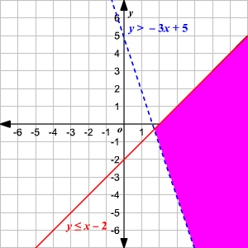
LO: Graph, write systems of inequalities SLE: Meet or exceed CCSS
Systems of inequalities can be solved by graphing:
Graph the lines
a. dashed lines mean >
b. Solid lines mean >
2. Solutions are defined in terms of y (the dependent variable)
3. Regions that represent solution “zones” for both lines are shaded.
4. Question: in this system of inequalities, is (5, -1) a valid solution?

Slide 78
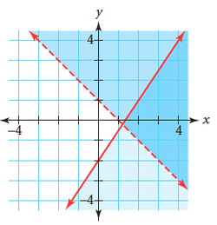
Conversely, systems of equations can be inferred from the graphs of their lines.
What is the system of inequalities that is represented by this graph?

Slide 79
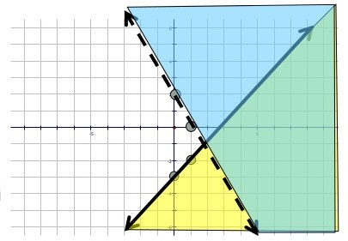
Practice:
3. Write a system of inequalities from this graph:
Graph these systems of equalities:
y > 2x – 5
3x + 4y < 12
2. y > -x – 2
2x + 4y > 4

Slide 80
Homework:
LO: Graph, write systems of inequalities
SLE: Meet or exceed CCSS
p. 414-415
#1- 19 all
Use Graph paper, please.

Slide 81
Good morning:
1.) Solve by substitution: y = 3x + 11
2x + y = 1
2.) Solve by elimination: 2x – 3y = 5
x + 2y = -1
3.) An airplane flew for 6 hours with a 22km/h tailwind. The return flight against the same wind took 8 hours. Find the speed of the plane through the air (not over the ground).
4.) Solve this system of inequalities by graphing:
x – y < 10
x > 3

Slide 82
Good morning:
1.) Write 5,620,000 in scientific notation.
2.) A triangle has sides of 2cm, 5cm and 9cm. Is it a real triangle? How do you know?
3.) You have 15 coins in your pocket. They are all quarters or nickels. The total value of the coins is $2.75. How many of each kind of coin do you have?

Slide 83
Exponential Expressions:
An exponential expression is (as you may have guessed) an expression that contains one or more exponents.
Positive exponents are easy:
4² = 4 x 4 = 16
3⁴ = 3 x 3 x 3 x 3 = 81

Slide 84
Zero exponents are even easier to calculate, but harder to explain:
5⁰ = 1
65⁰ = 1
7,300,000⁰ = 1
Anything raised to the zero power always equals 1. (We’ll explain why this is so later.)
Warning: 0⁰ does not equal 1; it is undefined. (0³ = 0; 0² = 0; 0¹ = 0; 0⁰ = undefined)

Slide 85
Negative exponents:
Negative exponents mean that the number is a reciprocal:
2⁻² = 1 = 1
2² 4
4⁻³ = 1/4³ = 1/64

Slide 86
Simplifying exponential expressions:
4 xy⁻³ = 4x(1/y³) = 4x
y³
5m⁻³ = 5
m³
2 2a³
a⁻³

Slide 87
Multiplying exponential expressions:
If numbers or variables have the same base, you can multiply them by adding up the exponents:
x³ * x² = x * x *x * x * x = x⁵
2x³ * 3x⁴ = 6x⁷

Slide 88
Practice:
1.) x ⁻⁴ y =
2.) a⁻⁴x⁰ =
3.) n² * n⁴ * n⁻¹ =
4.) m² * n⁰ * m⁻⁴ =

Slide 89
Homework:
LO: Simplify exponential expressions.
SLE: Meet or exceed CCSS
p. 433 2-44 even

Slide 90
Good morning:
1.) (3x + 2)(2x -7) = ?
2.) Write the equation (in slope-intercept form) for a line that passes through these two points: (-6,6) (3,3)
3.) Solve: -3(4-m) > 2(4m – 14) Graph the solution on a coordinate plane.

Slide 91
LO: Simplify exponential expressions SLE: Meet or exceed CCSS
Raising powers to a power:
When you raise an exponent to another power, multiply the exponents:
(5⁴)³ = 5¹²
(x²)⁵ = x¹⁰
(3x²)² = 9x⁴

Slide 92
Practice:
1.) (5y)⁴
2.) (2y⁻⁴)³
3.) (mg⁴)⁻¹ (mg⁴)
4.) 3²(3x)³
5.) (2 x 10⁻¹⁰)³

Slide 93
Homework:
LO: Simplify exponential expressions
SLE: Meet or exceed CCSS
p. 449-450 #2-30 even, 42-50 even

Slide 94
Good morning:
1.) Solve: |2x – 4| = 32
2.) (8x² + 15x – 2) + (2x² – 7x + 4) = ?
3.) simplify in scientific notation:
(5.2 x 10³)⁻⁵
^{4.)} (-2d³e³)(6d⁴e⁶)^{2 = ?}

Slide 95
Good Morning:
1.) (2⁻³)⁴
2.) (y⁶)⁻³ * y²¹
3.) b⁻⁹ * (b²)⁴
4.) (3.5 x 10⁻⁶)(4.6 x 10⁴)
5.) (x⁻³y²)⁻⁸ * y⁰

Slide 96
LO: Simplify exponential expressions SLE: Meet or exceed CCSS
Checkpoint Quiz on Simplifying Exponential Expressions:
Simplify:
1.) (2y⁴)³
2.) (mg⁴)⁻¹ (mg⁴)
3.) Answer in scientific notation:
(3.2 X 10²)(2.4 x 10⁻⁴)
4.) (7x⁻³y⁴)⁻²
5.) (24a⁻⁴b³c⁻¹d⁹)⁰

Slide 97
Good morning:
1.) Simplify: (6x⁻²y³)⁻³
2.) -2|3x – 4| = -12
3.) Graph on a coordinate plane:
y > 2x – 1
2x + 4y < 8

Slide 98
Homework:
LO: Divide exponential expressions
SLE: Meet or exceed CCSS
p. 456 #2-48 even

Slide 99
Bon Jour!
1.) A sphere has a volume that is numerically equal to its surface area. What is the radius of this sphere?
2.) If (8,9) is the center of a circle with a radius of ten units, at how many points does the circle intersect the coordinate axes?
3.) If x + 1/y = 1/5 and y + 1/x = 20, what is the value of xy?

Slide 100
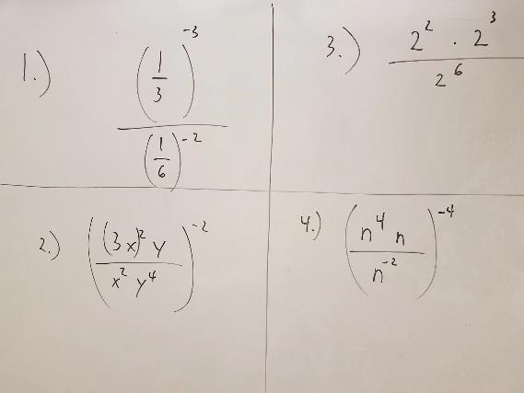
LO: Divide exponential expressions. SLE: Meet or exceed CCSS.
Additional Practice:

Slide 101
: صباح الخير
1.) Write answer in scientific notation:
(3.4 x 10¹²) (2.9 x 10⁻¹¹)
2.) Simplify: (2x⁻⁴)⁻²
2x⁴
3.) Solve: 2x + 1 = 3x – 2
3 2 4 6

Slide 102
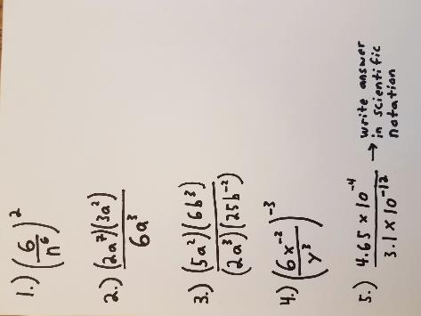
LO: Divide exponential expressions SLE: Meet or exceed CCSS Checkpoint Quiz on Dividing Exponential Expressions:

Slide 103
LO: Evaluate, graph exponential functions SLE: Meet or exceed CCSS
Exponential Functions:
A exponential function is a function in the form of
y = a * b^{x} (the x, the independent variable, is an exponent).
The domain of an exponential function refers to the range of possible values for the exponent x:
Evaluate y = 4^{x} for the domain {-2, 0, 3}:
4⁻² = 1/16, 4⁰ = 1, 4³ = 64;
The possible values for y are 1/16, 1, and 64

Slide 104
Evaluate these functions for the domain {-1, 2, 4}:
1.) y = 10 * 5^{x}
2.) f(x) = 3^{x}
3.) y = 20 * 3^{x}

Slide 105
Graphing Exponential Functions:
When graphing exponential functions, it’s necessary to plot coordinates on a table first:
y= 2 * 2^{x}
x | y
-2
-1
0
1
2

Slide 106
Practice Graphing:
Graph these functions. You may need to use bigger unit “steps” in your coordinate planes:
1.) y = 0.5^{x}
2.) y = 0.5 * 2^{x}
3.) y = 2 * 0.5^{x}

Slide 107
Homework:
LO: Evaluate and graph exponential functions.
SLE: Meet or exceed CCSS
p. 470-471
#1-8, 19-22, 25, 27

Slide 108
Good morning:
1.) Using y = 2 * 3^{x}, find the value of y for the domain {-2, -1, 0, 1 and 2}
2.) A rectangular prism is 5cm long, 3 cm high, and 3cm wide. What is the surface area of the rectangular prism?
3.) Find the next three terms of this sequence:
4, 6, 9, 13.5…..

Slide 109
LO: Use functions to model exponential growth and decay. SLE: Meet or exceed CCSS
Exponential vs. linear rates of change:
A linear rate of change is constant; if you graph it, it appears as a straight line.
y= 2x + 1 is a linear function.
2. An exponential rate of change is one that is constantly increasing or decreasing; if you graph it, it appears as a curve.
y = 5(1.5)^{x} is an exponential function

Slide 110
Using exponential functions to predict rates of growth or decay:
Exponential change can be modeled with this function:
y = a(b)^{x} , where
a = original value
b = growth factor (expressed as a decimal)
x = number of changes (years, payments, etc.)

Slide 111
Example:
Since 1997 (20 years ago), the average daily cost to care for patients in US hospitals has increased by 4% per year. In 1997, it cost $968/day to care for a hospital patient. What does it cost in 2017?
a = original amount, 968
b = growth factor 104% per year; 1.04 as a decimal
x = number of years, 20
y= 968(1.04)²⁰ = $2,121.00/day in 2017

Slide 112
Practice:
1.) In 2003, when my niece was born, her parents deposited $10,000.00 in a college fund that pays 5.5%, compounded annually. How much money will be in the account when she graduates from high school in 2021?
2.) A 2017 Tesla Model S, equipped with GPS, a nice sound system, and Blue Tooth, sells for $135,000.00 new. Its rate of depreciation is pretty good for a car, only 25% per year. If you buy this car today and drive it for 6 years, how much will you be able to sell it for?

Slide 113
Homework:
LO: Use exponential functions to model rates of growth and decay.
SLE: Meet or exceed CCSS.
p. 479-480
#5-10, 16-20, 31-35 all

Slide 114
Good morning:
1.) A cylinder is 15cm high and has a diameter of 20cm. What is the surface area of the cylinder?
2.) A forest has a total area of 10,000 square kilometers today. If 2% of the forest is logged every year, how much of the forest will be left in 12 years?
3.) Solve: -12 < 3x – 4 < 36 (Graph the solution on a number line.)

Slide 115
góðan morgun:
1.) You deposit $10,000 in an account that pays 4% interest, compounded quarterly. How much will be in the account in 10 years?
2.) Find the next two numbers in this sequence:
1,1,2,3,5,8,13…….
3.) Find the solution to this system of equations:
2x + 5y = -22
10x + 3y = 22

Slide 116
Unusual interest rates:
You’ve probably been doing these incorrectly:
Suppose your parents put $1500 in an account paying 3.5% interest, compounded quarterly. Find the balance of the account when you turn 18.
1.) The interest is 3.5% annually, but this interest rate is compounded quarterly. So, the interest paid is 3.5%/4, or 0.875% every three months. The growth factor = 1.00875.
2.) There are 72 quarters in 18 years, so the exponent is 72.
3.) use an exponential function: y = 1500(1.00875)⁷²
= $2,808.71

Slide 117
Practice:
1.) You deposit $200.00 into an acount that pays 5% annual interest, compounded monthly. How much will be in the account in the year 2100?
2.) Plutonium has a half-life of 25,000 years. If you have 2kg of this deadly element, and hide it under your sibling’s bed, how much of it will be left in 1,000,000 years?
3.) Seattle, with a population of 700,000, has an annual growth rate of 3.1% per year. If the city continues to grow at this rate, how many people will live here in 2030?

Slide 118
Good morning:
1.) You buy a boat for $77,000.00. The value of the boat decreases by 20% per year. How much will the boat be worth in 12 years?
2.) Simplify: (6.5 x 10⁸) (8.2 x 10⁻⁴) → in scientific notation
3.) Simplify: (6x³y⁷)⁻² (3x⁻²y)⁻³

Slide 119
Let’s review:
1.) ​(12x⁴y⁻²)⁴
(4x⁻²y³)⁻²
2.) Evaluate y = 0.1^{x} for the domain {-2, -1, 1, 2}
3.) Graph y = 2.5^{x}
4.) Since 1800, the human population has grown at an average annual rate of 1.1% per year. At this growth rate, what will be the human population of the earth in 2050?

Slide 120
Good morning:
1.) Simplify: (2x⁻³y⁰z²)²
(6x²y⁻³z⁻²)⁻³
2.) Write in scientific notation: 0.00424
3.) You borrow $250 from a classmate, and don’t pay her back for 8 years. If she charges 5% interest, compounded semiannually, how much will you owe her?

Slide 121
Good morning! Welcome to factoring!
1.) Graph: y = 2 * 0.5^{x}
2.) Subtract: (2x² + 2x – 9) – ( 4x² + x – 4)
3.) (2x + 4)² = ????

Slide 122
LO: Factor polynomials SLE: Meet or exceed CCSS
What’s a Polynomial?
3x: monomial (one term)
3x + 4: binomial (two terms)
X² + 2x – 2: trinomial
3x³ + 2x² + 3x – 2: polynomial
Generally, a polynomial is an expression with two or more terms.

Slide 123
Performing operations with polynomials:
Adding: Only like terms (variables and exponents) can be added:
3x² + 2x + 7 + 2x² + 4x = 5x² + 6x + 7
Multiplying: Use distributive property:
8m(m+6) = 8m² + 48m

Slide 124
Factoring polynomials:
3x³ – 12x² + 15x
Step 1: Find the greatest common factor (GCF); in this case, it’s 3x.
Step 2: Divide out the GCF:
3x(x – 4x + 5)

Slide 125
Practice:
Simplify:
1.) 4b(5b² + b + 6)
2.) -7h(3h² – 8h – 1)
3.) (2x² + 4x – 2) – (4x – 2x + 8)
Factor:
4.) 15w + 21
5.) 24x³ – 96x² + 48x

Slide 126
Homework:
LO: Factor polynomials
SLE: Meet or exceed CCSS
p. 501-502 #2-38 even

Slide 127
Good Morning:
1.) Write the equation of a line, in slope-intercept form, of a line that passes through (2,5) and (1, -2).
2.) Fred and Ned leave school at the same time. Fred travels north at a speed of 30km/h. Ned travels east at a speed of 50km/h. How far apart are the two after 3 hours?
3.) (6x + 2) ² = ?

Slide 128
LO: Multiply binomials SLE: Meet or exceed CCSS
How to multiply binomials:
Use the distributive property twice (otherwise known as FOIL: first, outside, inside, last):
(2x + 2) (3x + 4) = 6x² + 8x + 6x + 8
Then combine like terms:
6x² + 14x + 8

Slide 129
Practice:
1.) (x + 4) (2x – 3)
2.) (4x – 7) (3x – 5)
3.) (5x – 4) (8x – 1)
4.( 3x + 4)²
5.) (x – 9)²

Slide 130
Homework:
LO: Multiply binomials
SLE: Meet or exceed CCSS
p. 507-508 #6-38 even

Slide 131
Good Morning:
1.) Multiply: (3x – 5) (2x + 4)
2.) Write the equation of a line, in slope-intercept form, that is perpendicular to y = 2x -1 and passes through (4, 6)
3.) Solve: |3x – 2| = 22
4.) Simplify: (2x² + 7x – 3) – (8x² – 12x – 10)

Slide 132
LO: Factor trinomials in x² + bx + c form SLE: Meet or exceed CCSS
How to factor trinomials:
Factoring trinomials is basically multiplying binomials in reverse.
x² + 7x + 12, when factored, will result in two binomials:
(x )(x ) → x * x = x², the first term in the trinomial.
For the 2nd and 3rd terms (bx and c), find two factors of 12 that add up to 7; those factors are 3 and 4:
(x + 3) (x + 4)
Then check by multiplying the binomials; if you end up with the original trinomial, you did it correctly:
X² + 7x + 12

Slide 133
Practice:
1.) r² + 4r + 3
2.) t² – 13t + 42
3.) n² + 10n – 56
4.) m² + 14m – 51
5.) t² – 10t – 75

Slide 134
Homework:
LO: Factor trinomials
SLE: Meet or exceed CCSS
p. 521-522
#3-54
Multiples of 3 (3, 6, 9, 12, etc.)

Slide 135
LO: multiply/factor polynomials SLE: Meet or exceed CCSS
Checkpoint Quiz on Simple Factoring:
Multiply:
1.) (3x + 2)(3x – 7)
2.) (x + 3)(2x² + 4x – 5)
Factor by finding the GCF:
3.) 10x³ – 25x + 20
4.) 24x³ – 96x² + 48 x
5.) 6a² – 8a

Slide 136
Good morning:
1.) solve: 7x + 6y = 33
4x – 12 y = -12
2.) Factor using GCF: 9m¹² – 36m⁷ + 81m⁵
3.) Multiply: (2x + 3)(x – 7)
4.) Factor: p² – 15p + 54

Slide 137
LO: Factor trinomials SLE: Meet or exceed CCSS
Factor these trinomials:
1.) 2n² + 15n + 7
2.) 6t ² + 25t + 11
3.) 8y² + 30y + 13
4.) 2x² – 11x – 21
5.) 25x² – 10x – 15

Slide 138
Homework:
LO: Factor trinomials SLE: Meet or exceed CCSS
p. 525-526
#2-26 even, 39- 41 all

Slide 139
Happy National Ding a Ling Day!
1.) Write product in scientific notation:
(4.6 x 10¹²) (5.5 x 10⁻⁵)
2.) Factor: 7x² – 30x + 27
3.) A smooth column is 10m high and has a diameter of 2m. What is the surface area of the column?

Slide 140
More factoring fun!
1.) 2t² – t – 3
2.) 2x² – 11x – 21
3.) x² + 8x + 16
4.) 9x² + 12x + 4
5.) 56x³ + 43x² + 5x
6.) 54p² + 87p + 28

Slide 141
Good morning:
1.) Simplify: (x³)(x⁷)⁻²
2.) Factor: y² – 16y + 64
3.) Solve: 8x + 2y = 50
y = -4x + 25
4.) Factor: 2w³ + w² + 14w + 7

Slide 142
LO: Factor four-term polynomials SLE: Meet or exceed CCSS
How to factor by grouping:
4n³ + 8n² – 5n – 10
Step 1: factor the GCF from each set of two terms:
4n²(n + 2) – 5(n + 2)
Step 2: factor out (n + 2):
(4n² -5) (n + 2)
Step 3: Check using foil:
4n³ + 8n² – 5n – 10 ✔

Slide 143
Practice:
1.) 5t⁴ + 20t³ + 6t + 24
2.) 2w³ + w² – 14w – 7
3.) 14w³ + 49 w² – 8w – 28
4.) 2m³ – 32m² – m + 16
5.) 25x³ – x² - 50x + 2

Slide 144
Homework:
LO: Factor four-term polynomials
SLE: Meet or exceed CCSS
p. 537 #1-16 all

Slide 145
LO: Factor polynomials SLE: Meet or exceed CCSS
Good morning:
1.) x² + 6x + 8
2.) r² – 14r – 51
3.) n² – 4n – 21
4.) 5x² – 11x + 2
5.) 2x² – 5x – 12
6.) 6x³ + 3x² + 8x + 4

Slide 146
Happy 13th Amendment Day!
Factor:
1.) x² – 9
2.) 5n³ – 20n
3.) 4a² – 81
4.) 8m² – 16m + 8

Slide 147
More Practice:
Factor:
1.) 2x³ + 8x² + x + 4
2.) 8x⁴ + 6x – 28x³ – 21
3.) 5x³ – x² + 15x – 3
4.) x³ + 3x² + 4x + 12
5.) 10x³ – 25x² + 4x – 10

Slide 148
LO: Factor special cases SLE: Meet or exceed CCSS
Perfect square trinomials:
n² – 16n + 64 = (n -8)(n-8) = (n-8)²
9g² - 12 + 4 = (3g -2)(3g – 2) = (3g -2)²
II. Difference of two squares:
x² – 64 = (x + 8)(x – 8)
4x² – 81 = (2x +9) (2x – 9)
III. Factoring out a common factor first:
8y² – 50 = 2(4y² – 25) = 2(2y + 5)(2y – 5)

Slide 149
Try it:
1.) k² – 16k + 64
2.) 64r² – 144r + 81
3.) x² – 100
4.) 6r³ – 150r
5.) 144x² – 1

Slide 150
Homework:
LO: Factor special cases
SLE: Meet or exceed CCSS
p. 531 #2-38 even

Slide 151
Good Morning:
1.) Solve: 5 = 7
2 –x 10
2.) Graph: y = |x| + 2
3.) Factor: d² – 18d + 56
4.) Factor: 21h² + 72h – 48

Slide 152
Merry Christmas!
1.) On the evening of December 24, the reindeer Blitzen wakes up to find that Santa and the other reindeer have left on their gift-giving mission without him. He knows that Santa left at 6:00 PM, and was traveling at a speed of 450km/h. If Blitzen leaves at 8:00 PM and travels at a speed of 650 km/h, at what time will he catch up to Santa?
2.) Every New Year, Santa gives his elves a bonus of $1000.00 each. One enterprising elf puts all of this bonus into an account that pays 3.5% annual compounded interest. If he does this every year for 10 years, how much total money will he have in his account when he quits and retires to Florida?
3.) Santa wants to build a new barn for his reindeer. It will be rectangular, 100m long, 50m wide and 10m high. It will have a marble floor, but the rest of the barn will be made out of wooden planks. If each plank is 2m long and 0.5m wide, how many planks does Santa need to build the barn?

Slide 153
Happy New Year!
1.) Solve: 2x – 4 = 144
12 2x + 4
2.) Factor: 12y² – 10
3.) Factor: 5t⁶ + 25t³ – 10t
4.) Factor: x² – 18x + 45

Slide 154
More factoring practice:
1.) (3x + 2) (2x – 7) =
2.) x² – 2x – 15
3.) 6x² + 10x + 4
4.) 6x³ + 3x² + 8x – 6 (factor by grouping)
5.) 16x² – 144

Slide 155
Good Morning!
1.) A piece of glass with an initial temperature of 99º C is cooled at a rate of 3.5º C per minute. At the same time, a piece of copper with an initial tmeperature of 0º C is heated at a rate of 2.5º C per minute. At what time will the glass and the copper be the same temperature?
2.) You purchase a used car for $9000. It has a rate of depreciation of 15% per year. How much will the car be worth in 5 years?
3.) Factor: 18v⁴ + 27v³ + 36v²

Slide 156
Factoring by Grouping:
1.) 5t⁴ + 20t³ + 6t + 24
2.) 2w³ + w² – 14w – 7
3.) 12v³ – 32v² + 6v – 16
4.) 20m³ – 18m² + 40m – 36

Slide 157
Happy Birthday, David Bowie!
Factor:
1.) x² + 3x + 2
2.) 6x² + 10x + 4
3.) 15y² + 16y + 1
4.) x² + 6x + 9
5.) 16x² – 169
6.) 6x³ + 3x² + 8x + 4
7.) 15h³ + 11h² – 45h – 33

Slide 158
Suggested Review:
LO: Factor polynomials
SLE: Meet or exceed CCSS
p. 542-543 #26-72 even, 80-90 even, as needed.

Slide 159
Good Morning:
1.) Solve: 4x – 3y = 8
y = -2x – 1
2.) Graph y = |x + 1|
3.) You design a Wonder Woman/Superman suit that allows you to fly to a nearby town, 18km away. With a tailwind, the trip takes 20 minutes. Your return trip with a headwind takes 36 minutes. Find your flying speed, and the speed of the wind.

Slide 160
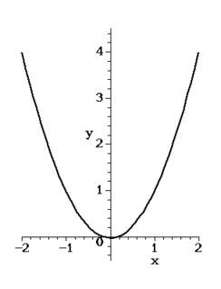
LO: Graph quadratic functions SLE: Meet or exceed CCSS
Standard Form of a Quadratic Function:
A quadratic function shows the relationship between two variables, one of which contains an exponent. The standard form is:
y = ax² + bx + c (a ≠ 0)
Most quadratic functions are parabolas (a big U shape).

Slide 161
Quadratic functions can be graphed using a table of values for x and y. It’s useful to keep the x values small, so the graph doesn’t get ridiculously large:
y = x² + 2

Slide 162
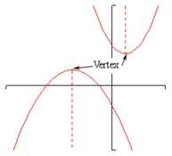
Parts of a parabola:
Vertex: The minimum or maximum value of the parabola (if the parbola opens upward, the vertex is a minimum; if it opens downward, it’s a maximum).
Axis of symmetry: An imaginary vertical line that divides the parabola into two equal halves.

Slide 163
Graph these functions:
y = 2x² - 1
y = 0.5x² + 2
y = x² – 2x + 1
y = -x² + 4
y = x² + x – 2

Slide 164
Homework:
LO: Graph quadratic functions
SLE: Meet or exceed CCSS
p. 553-554 #4-9, 14-20 all (Use graph paper, please.)

Slide 165
Good Morning:
1.) Cesium-137, a radioactive element, has a half-life of 30 years. If you store 1kg of cesium-137 in a box under a sibling’s bed, how much of the sample will be left in 2109?
2.) Solve: 2x – 4 = x + 2
12 6
3.) Graph: y = x² + 2x – 2

Slide 166
LO: Graph quadratic functions using the axis of symmetry. SLE: Meet or exceed CCSS
p. 560-561 #2-10 even, 23-31 all

Slide 167
Good morning:
Graph y = 2x² + 4x + 2 (Using axis of symmetry)
You throw three darts at a dart board that is split into 20 different numbered regions. What is the probability that all three darts will land in the 20 region?
Factor: 2t² + 3t - 2

Slide 168
More Graphing practice:
1.) y = 2x² + 4x – 5
2.) y = 3x² – 9x + 5
3.) y = 2x² + 3

Slide 169
Good morning:
Graph y = x² – 3x + 2
The formula h = -4.9t² + 3.83t + 1.7 gives the height of a volleyball that is served during a game. h gives the height in meters and t the time in seconds. At what time will the ball be at its greatest height?
You invest $4000 in an account that earns 8% annual compounded interest. How much will the account be worth after 10 years?

Slide 170
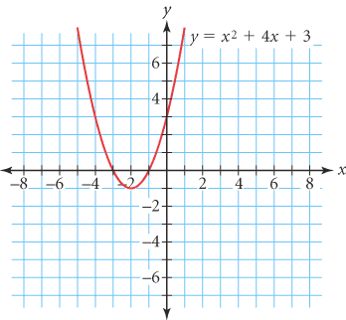
LO: Solve quadratic equations SLE: Meet or exceed CCSS
Solving quadratic equations by graphing:
In quadratic functions, the number of possible x values is infinite. However, for the purposes of this course, we will only consider the values of x when y = 0. (In other words, the solutions of a quadratic function are where the parabola crosses the x axis.)

Slide 171
Solve by graphing:
1.) x² – 1 = 0
2.) 2x² + 4 = 0
3.) –x² + 2x + 2 = 0

Slide 172
Solving equations by using square roots:
Example:
2x² – 98 = 0
2x² = 98
X² = 49
X = √49
X= ±7

Slide 173
Solve:
1.) t² - 25 = 0
2.) 3n² + 12 = 12
3.) 3x² + 4 = 0

Slide 174
Homework:
LO: Solve quadratic equations
SLE: Meet or exceed CCSS
p. 567 #1-21 all

Slide 175
Good morning:
1.) Solve: 2(8x – 7) = 6(5x – 4)
2.) Solve: x² + 10x + 16 = 0
3.) Find the length of the line segment with end points at (1,1) and (-2, -6) on the coordinate plane.

Slide 176
Happy Purple and Gold Day!
1.) Solve: -10 < 7x + 4 < 32
2.) Solve: 2x – 4y = 24
y = -0.5x – 6
3.) The Lazy River has a current of 2 miles per hour. A motorboat can travel 15 miles down the river in the same amount of time it takes to travel 9 miles up the river. What is the speed of the boat in still water?

Slide 177
LO: Solve quadratic equations by factoring: SLE: Meet or exceed CCSS
Using factoring to solve quadratic equations is based on the Zero-Product Property:
If ab = 0 then a = 0 or b = 0
Example of solving quadratic equations by using the Zero-Product Property:
(x + 5)(2x – 6) = 0
X + 5 = 0; 2x – 6 = 0
X = - 5 2x = 6
x = 3
X = -5, 3

Slide 178
Solving quadratic equations by factoring:
X² + 6x = - 8
X² + 6x + 8 = 0 → Factoring only works if the
equation = 0
(X + 2)(x + 4) = 0
X = -2, - 4

Slide 179
Practice:
1.) x² + 3x – 4 = 0
2.) x² – 8x = 0
3.) x² + 8x = - 15
4.) 6n² – 5n = 4

Slide 180
Homework:
LO: Solve quadratic equations by factoring
SLE: Meet or exceed CCSS
p. 574- 575 #2-32 even, 44

Slide 181
Good morning!
1.) Solve: 2(3x – 4) = 4x + 2
6 2
2.) Factor: 4x² – 169
3.) Solve: 2x² – 13x – 24 = 0

Slide 182
Practice:
1.) (x – 9)(x + 8) = 0
2.) a² + 6a – 72 = 0
3.) c² – 81 = 0
4.) 3x² + 8x = 3

Slide 183
Good Morning:
1.) Write an equation in slope-intercept form for a linear equation that passes through (4,9) and (-2,-6).
2.) A cylinder is 25cm tall and has a diameter of 5cm. What is the surface area of the cylinder?
3.) Solve: x² – 3x = 40

Slide 184
LO: Solve quadratic equations by completing the square. SLE: Meet or exceed CCSS
Perfect Square trinomial:
X² + 8x + 16 = (x + 4) (x + 4) = (x + 4)²
Quadratic equations in ax² + bx + c = 0 form can be transformed into perfect square trinomials in order to solve them (completing the square):
x² – 20x + 32 = 0
x² – 20x = -32
x² – 20x + 100 = -32 + 100 → divide b by 2 and square it.
(x – 10)² = 68
X – 10 = ±8.25 → find square roots.
X -10 = 8.25 or x – 10 = -8.25
X = 18.25 or 1.75
Note: this technique works only if a = 1!

Slide 185
Try it:
1.) x² – 6x = 247
2.) x² + 5x + 3 = 0
3.) x² – 14x + 16 = 0
4.) x² + 9x = 136
5.) 4a² – 8a = 24

Slide 186
Homework:
LO: Solve quadratic equations by completing the square.
SLE: Meet or exceed NGSS
p. 582 #2-34 even, 35

Slide 187
Good morning!
1.) The diameter of the earth is 12,900km. What is the total surface area of Earth?
2.) Graph y = 2x² + 4x – 2
3.) Solve: x² + 18x – 319 = 0

Slide 188
More Practice:
1.) x² – 2x = 120
2.) 2x² – 3x – 2 = 0
3.) x² – 7x = 0
4.) 10x² + 3x = 4

Slide 189
LO: Solve quadratic equations SLE: Meet or exceed CCSS
Solve by factoring:
1.) x² + 6x + 8 = 0
2.) 2x² + 22x = - 60
Solve by completing the square:
3.) x² – 20x + 32 = 0
4.) x² + 5x + 3 = 0
5.) y² – 8y = - 12

Slide 190
Good morning:
Solve by factoring or completing the square:
1.) 5x² - 10x = 0
2.) x² + 7x + 12 = 0
3.) 3d² – 24d = 3
4.) k² + 4k + 11 = -10

Slide 191
Good Morning:
Solve for x: (bwaa haa haa…)
ax² + bx + c = 0

Slide 192
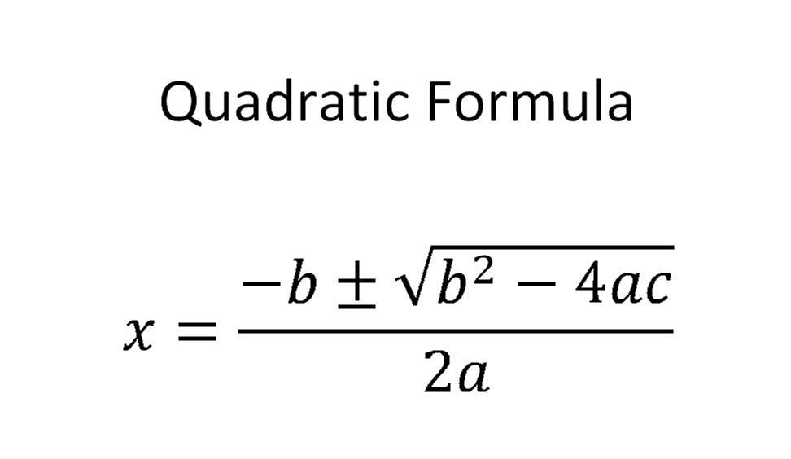
​
​

Slide 193
Homework:
LO: Use quadratic formula
SLE: Meet or exceed CCSS
p. 588 #1-17 all

Slide 194
Good morning:
1.) Solve by factoring: x² + 11x + 18 = 0
2. ) Solve by completing the square:
x² - 2x = 120
3.) Solve by using the quadratic formula:
6m² – 13m = 19

Slide 195
Solve using the quadratic formula:
1.) x² + 6 = 5x
2.) 2x² + 4x – 7 = 0
3.) A football player kicks a ball and gives it an upward initial velocity of 47ft/s. The starting height of the ball is 3 ft. If no one catches the football, how long will it be in the air?
(Use h = -16t² + vt + s )

Slide 196
Happy Crazy Sock Day!
Solve: 6y + 8x = 28
3 = 2x – y
Jack is driving a boat. The boat can go 10 mph in still water. The current of the river is 4 mph. Jack wants to go to a town that is 90 miles up-river. How long will it take Jack to get there (give your response in hours and minutes)?
Solve using any method: 49x² – 169 = 0

Slide 197
Solve using quadratic equations or functions:
A farmer has a field that is 1000 m². If the field is 20m longer than twice its width, what are the dimensions of the field?
A toy rocket is launched vertically upward from ground level with an initial velocity of 128 ft/s. Its path of travel can can be expressed by the equation h(t) = -16t² + 128t.
a. How long will it take the rocket to hit the ground?
b. What will the rocket’s maximum height be?
c. How many seconds will it take the rocket to reach its maximum height?
3. A rectangle has an area of 60m² with a length that is 1m more than its width. What are the dimensions of the rectangle?

Slide 198
Good morning:
1.) simplify: (-3r⁻³)² (-r³)⁴
2.) Solve: x² + 4x – 16 = 0
3.) Suppose you throw a ball in the air. The ball is 6 ft. high when it leaves your hand. If it has an initial velocity of 20 ft/s, for how many seconds will it stay in the air? (h = -16t² + vt + s)

Slide 199
LO: Use the quadratic formula SLE: Meet or exceed CCSS
Checkpoint Quiz on the Quadratic Formula:
Solve using the quadratic formula:
1.) 2x² – 7x = -3
2.) 4x² + 3x – 8 = 0
3.) x² + 8x = 4
Solve using quadratic equations:
4.) A pool is 2m longer than twice its width. Its area is 160m². What are the dimensions of the pool?
5.) The area of a rectangular patio is 800m². The patio is twice as long as it is wide. What are the dimensions of the patio?

Slide 200
Do These:
1.) A rectangle has an area of 60m² with a length that is 1m more than its width. What are the dimensions of the rectangle?
2.) A right triangle has one side that is 3cm shorter than the hypotenuse, but twice as long as the third side. What are the dimensions of the triangle?
3.) A football player kicks a football in the air with a staring height of 3.5 ft and an initial upward velocity of 38.4 ft. second.
a.) If no one catches the ball, for how many seconds will it be in the air?
b.) What will its maximum height be?

Slide 201
Good morning:
1.) Solve by factoring: x² + 3x – 28 = 0
2.) Solve by completing the square:
2x² – 8x = 56
3.) Solve using the quadratic formula:
2x² + 4x = 7

Slide 202
Practice/Review:
Graph: y = x² – 9x + 3
Solve using any method:
2. 2x² + 4x = 15
3. 0.5x² + 4x = 7
4. x² – 8x = -12

Slide 203
Good morning:
1.) Graph: y = -3x² + 6x + 5
2.) Solve by graphing: x² – 9x + 16 = 0
3.) Solve by factoring: 2x² – 5x = 88
4.) Solve by completing the square:
x² + 8x = 48
5.) Solve using the quadratic formula:
5x² – 2x – 7 = 0
6.) A rectangle is 3m longer than twice its width. Its area is 80m². Find the dimensions of the rectangle.

Slide 204
Ooh, word problems!
1.) An object is launched at 19.6 meters per second (m/s) from a 58.8-meter tall platform. When does the object strike the ground?
2.) A picture has a height that is 4/3 its width. It is to be enlarged to have an area of 192 cm². What will be the dimensions of the enlargement?
3.) A garden measuring 12 meters by 16 meters is to have a pedestrian pathway installed all around it, increasing the total area to 285 square meters. What will be the width of the pathway?
4.) An object is launched directly upward at 30m/s from a platform 8m high . What will be the object's maximum height?

Slide 205
Good morning:
1.) Solve: The robotics club sells hats for $4 each and t-shirts for $10 each. The club sells 205 items in all and receives a total of $1084. Find the number of hats and shirts that were sold.
2.) A kitten grows from 5 oz at birth to 3lbs 6 oz at 6 months. Find the percentage of growth.
3.) A cylindrical building is 40m high and has a diameter of 20m. What is the total volume of the building?

Slide 206
Simplifying radical expressions:
A radical expression is an expression using square roots. To simplify radical expressions, divide out the perfect square factors:
√192 = √64 x √3 = 8√3
√250 = √25 x √10 = 5√10

Slide 207
Removing factors in variable form:
√45a⁵ = √9a⁴ x √5a = 3a²√5a
√27n² = √9n² x √3 = 3n√3
Multiplying radical expressions:
√8 x √12 = √96 = √16 x √6 = 4√6
5√3c x √6c = 5√18c² = 15c√2

Slide 208
Try these on your own:
1.) √200 =
2.) √20a⁵ =
3.) √75 =
4.) √22 x √11 =
5.) √3k x √51k³
6.) √a³b⁵c³

Slide 209
Homework:
LO: Simplify radical expressions
SLE: Meet or exceed CCSS
p. 619-620 #2-50 even

Slide 210
Good morning:
1.) Simplify: 6x³y⁻²z⁴
12x⁻²y⁵z⁻¹
2.) Solve: -3|2x – 1| = -24
3.) You put $4000.00 in an investment account that earns 7% interest compounded annually. How much will be in the account in 2050?

Slide 211
Good morning:
1.) Solve: 2x² + 16x = 28
2.) Solve and graph your solution on a number line:
|2x + 6| > 32
3.) The diameter of the earth is 12,900 km. Assuming a kayaking and/or walking speed of 5km/h, how long would it take you to paddle and walk from the North Pole to the South Pole?
4.) Simplify: √98x³

Slide 212
LO: Simplify radical expressions SLE: Meet or exceed CCSS
Checkpoint Quiz on Simplifying Radicals:
1.) √200 =
2.) -3√120 =
3.) √108b⁶ ⁼
4.) √72
√64
5.) 3√2
√6

Slide 213
LO: Perform operations with radical expressions. SLE: Meet or exceed NGSS
Adding and subtracting radicals:
If radical expressions have the same radical, they can simply be added or subtracted like variables:
3√5 + 2√5 = 5√5
√2 + 3√2 = 4√2

Slide 214
Using the distributive property:
√3(√6 + 7) = √18 + 7√3 = 3√2 + 7√3
(√7 + 4)² = (√7 + 4) (√7 + 4) =
7 + 4√7 + 4√7 + 16 =
8√7 + 23
(√5 + 2)(√5 + 5) = 5 + 5√5 + 2√5 + 10 =
7√5 + 15

Slide 215
Rationalizing the demominator:
(√5 + √3) and (√5 - √3) are conjugates; if you multiply them together, the radicals get canceled out:
(√5 + √3) (√5 - √3) =
5 – √15 + √15 – 3 =
5 – 3 = 2
This can be used to simplify rational expressions containing radicals:
3√3 + 2 (√3 - √2)
√3 + √2 (√3 - √2)
9 – 3√6 + 2√3 - 2√2
1
9 – 3√6 + 2√3 - 2√2

Slide 216
Good morning:
1.) -3√3 + 2√3 =
2.) 2√12 – 7√3 =
3.) 4√5 + 2√45 =
4.) √6( √6 – 5) =
5.) (2√10 + √3)² =
6.) – 12_____
√8 - √2
7.) __ 3____
√10 - √5

Slide 217
Homework:
LO: Perform operations on radical expressions
SLE: Meet or exceed NGSS
p. 625-627 #2-36 even, 64, 66

Slide 218
Good morning:
1.) Simplify: √360x³
2.) Solve: 2x² + 5x – 3 = 0
3.) Solve: 2x + 3y = 18
y = 2x – 4
4.) 2√2( √2 + 3√6) = ?

Slide 219
More practice:
https://cdn.kutasoftware.com/Worksheets/Alg2/Dividing%20Radicals.pdf

Slide 220
Good morning:
1.) √2 x √10 =
2.) Graph y = 2x² + 4x – 2
3.) Solve ax² + bx + c = 0 for x
4.) Sam leaves St. John driving at a speed of 30mph. Casey leaves an hour later, driving at a speed of 35mph. How long after Casey leaves St. John will he catch up with Sam?

Slide 221
Good morning:
1.) √45 + √72 =
2.) Solve (3x + 2)² = 42
3.) Graph |x + 2| = y
4.) A rectangular prism is 4cm wide, 2cm high, and 8cm long. What is the surface area of the prism?

Slide 222
Good morning:
1.) Add: 6/7 + 2/5 =
2.) √14 – 2
√7 - √2
3.) √24 + √44 =
4.) Charlie runs (no, really, runs) to the store to buy chocolate milk. On the way there, he runs at a speed of 7 mph; the trip takes him 0.5h. On the way home, the trip takes 0.333 hours. How fast did Charlie run on the way home?

Slide 223
LO: Solve radical equations. SLE: Meet or exceed CCSS
To solve radical equations:
Isolate the radical (or one of the radicals) to one side of the equal sign.
2. If the radical is a square root, square each side of the
equation. (If the radical is not a square root, raise each side to a power equal to the index of the root.)
3. Solve the resulting equation.
4. Check your answer(s) to avoid extraneous roots (roots that do not result in a correct solution to the equation).
5. When squaring both sides of the equation, square each side, not each term.

Slide 224
Solving by isolating the radical:
√x – 3 = 4
√x = 7
x = 49 (-49 is an extraneous solution, since
√-49 is not a real number.)

Slide 225
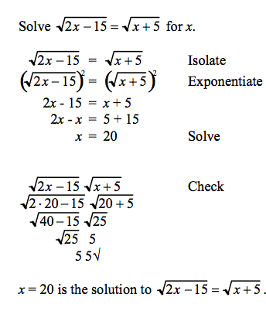
Solving with radicals on both sides:

Slide 226
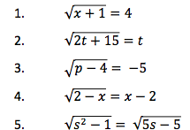
Practice Problems:

Slide 227
Homework:
LO: Solve radical equations
SLE: Meet or exceed CCSS
p. 632-633 #2-40 even

Slide 228
Good morning:
1.) A rectangular painting is surrounded by a 2cm-wide frame. The area of the painting with the frame is 200cm². What is the area of the painting alone?
2.) Solve: √3x + 4 = √x – 2
3.) solve for x: ax + by – c = b + c
4.) Graph y = |2x| - 6

Slide 229
Good morning:
Write an equation in slope-intercept form for a line that passes through (-1, 4) and (2,3)
Solve: x² + 10x – 21 = 0
A triangle has sides with lengths of 7.4cm, 9.3 cm, and 11.9cm. Is it a right triangle?
Solve: x = √x + 3

Slide 230
Trigonometric Ratios:

Slide 231
Good morning:
Solve: 2x – 5 = 2___
2 x + 2
2. Graph y = x² + 3 – 2
3. You’re in a boat 3km from shore. You see a lighthouse on the beach. The angle of elevation from your boat to the top of the lighthouse is 10º.
How tall is the lighthouse?

Slide 232
Solving word problems using trigonometric ratios:
1.) A tower casts a shadow that is 300m long. If the angle of elevation from the end of the shadow to the top of the tower is 50 degrees, how high is the tower?
2.) An airplane flies at an altitude of 5000m. When it lands, its angle of descent is 3º. How far, in horizontal distance, is the airplane from the beginning of the runway when the airplane begins its descent?
3.) You’re standing next to the window in Ms. Rzegocki’s classroom. You see your friend below in the courtyard, and foolishly decide to throw a grape at her head. The angle of the grape’s flight, as measured from the wall of the school, is 45º. The window is 9.5m above the ground. How far will the grape travel in its straight path toward the back of your friend’s head?
4.) You stand an unknown distance from the Space Needle. The Space Needle is 184m tall, and the angle of elevation from your location to the top is 67º. How far away from the Space Needle are you?

Slide 233
Homework:
LO: Solve problems using trigonometric ratios
SLE: Think critically and solve problems
p. 652-653 #1-15 all

Slide 234
Happy Pi Day!
Given that Saturn's moon Titan has a radius of 2575 kilometers, which is covered by a 600-kilometer atmosphere, what percentage of the moon's volume is atmospheric haze? Also, if scientists hope to create a global map of Titan's surface, what is the surface area that a future spacecraft would have to map?

Slide 235
Answer: 47 percent; 83,322,891 square kilometers

Slide 236
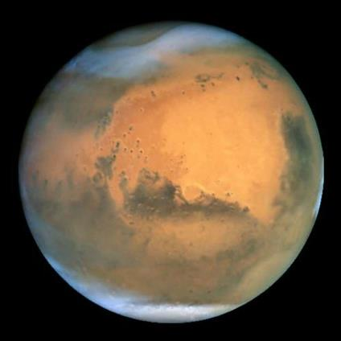
Given that Mars has a polar diameter of 6752 kilometers, and the Mars Reconnaissance Orbiter comes as close to the planet as 255 kilometers at the south pole and 320 kilometers at the north pole, how far does MRO travel in one orbit? (JPL advises, "MRO's orbit is near enough to circular that the formulas for circles can be used.")

Slide 237
Answer: 23,018 km

Slide 238
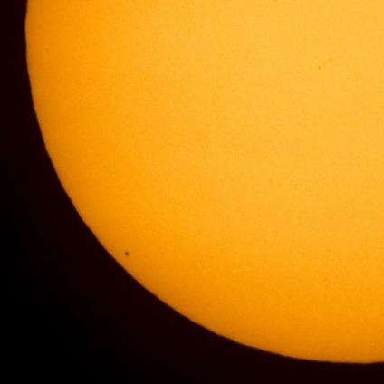
If 1360.8 w/m^2 of solar energy reaches the top of Earth's atmosphere, how many fewer watts reach Earth when Mercury (diameter = 12 seconds) transits the Sun (diameter = 1909 seconds)?

Slide 239
Answer: 0.05 w/m^2

Slide 240
Pi has long been noted as one of the most useful mathematical constants. Yet, due to the fact that it is an irrational number, it can never be expressed exactly as a fraction, and its decimal representation never ends. We have come to estimate π often, and all of these have been used as approximations to π in the past. Which is the closest one?
A) 3
B) 3.14
C) 22/7
D) 4
E) Square root of 10

Slide 241
Answer: C

Slide 242
The Soil Moisture Active Passive, or SMAP,
satellite is designed to image
1,000-kilometer-wide swaths of Earth
from a near-polar, sun-synchronous orbit
685 kilometers above Earth’s surface.
How many days will it take SMAP to
image all of Earth’s surface?

Slide 243
The Curiosity Mars rover doesn’t have an
odometer like those found in cars, so rover
drivers calculate how far the rover has driven
based on wheel rotations. Since landing
on Mars in August 2012, Curiosity’s
50-centimeter-diameter wheels have rotated
3689.2 times in 568 sols (Martian days).
How many kilometers has Curiosity traveled?

Slide 244
The Cassini spacecraft was launched to Saturn with its 28-inch spherical hydrazine tank filled to
69 percent of its volume with hydrazine. After many years of studying Saturn, 82 kilograms of
hydrazine have been used to maneuver around the ringed planet. Given the density of hydrazine is
1.02 grams/cubic centimeter, how much fuel is remaining in the tank?

Slide 245
Good morning:
1.) Two cars leave from the same place at the same time and travel in opposite directions. One car travels at 55 mph and the other at 75 mph. After how many hours will they be 520 miles apart?
2.) Jose left the White House and drove toward the recycling plant at an average speed of 40 km/h. Rob left some time later driving in the same direction at an average speed of 48 km/h. After driving for five hours Rob caught up with Jose. How long did Jose drive before Rob caught up?
4.) A cargo plane flew to the maintenance facility and back. It took one hour less time to get there than it did to get back. The average speed on the trip there was 220 mph. The average speed on the way back was 200 mph. How many hours did the trip there take?

Slide 246
Homework:
LO: Multiply and divide rational expressions
SLE: Meet or exceed CCSS
p. 679 #2-34 even

Slide 247
Welcome back:
1.) solve: 4x² + 24x = 320
2.) graph y > 2x – 1 on a coordinate plane.
3.) Multiply: y² – 16 * y + 3
2y + 6 y – 4

Slide 248
Good Morning:
1.) Add: 4 + 9
7 10
2.) Write in slope-intercept form:
(y – 4) = 3(x + 8)
3.) Solve 3|2x – 4| = 51

Slide 249
Homework:
LO: Add and subtract rational expressions
SLE: Meet or exceed CCSS
p. 689-690 #3-39, 45-51, multiples of three

Slide 250
Good morning:
1.) Solve this triangle:

Slide 251
Good morning:
1.) A garage door is 1m wider than twice its height. The area of the doorway is 136m². What are the dimensions of the doorway?
2.) The diameter of the earth is 12,000km. 66.7% of the surface of the earth is water. What is the approximate land surface area of the earth?
3.) Solve: √x + 16 = 64

Slide 252
Good morning:
1.) A submarine left Hawaii two hours before
an aircraft carrier. The vessels traveled in
opposite directions. The aircraft carrier
traveled at 25 mph for nine hours. After this
time the vessels were 280 mi. apart. Find
the submarine's speed.
2.) Abigail is 6 years older than jonathan. Six years ago, she was twice as old as he was. How old is each person now?
3.) Adena, Julius, and Tia volunteered to
read to children at the public library.
Julius worked two hours less than Tia.
Adena worked twice as many hours as
Julius. Altogether they worked 58 hours.
How many hours did Adena work?

Slide 253
Good morning:
1.) Graph using the axis of symmetry:
y = x² – 4x + 2
2.) Solve: 3(x + 2) = 9 ___
18 (x + 6)
3.) You go to Nordstrom with $200.00. You leave with a pair of shoes and $36.25. What percentage of your money did you spend on shoes?

Slide 254
Good morning:
1.) A helicopter travels to the East going 120 mph. Two hours later, it is determined that the helicopter will need to be escorted on its journey to the East. How long will it take an F-14, traveling at 900 mph to catch up with the helicopter?
2.) A rectangular prism is 20cm long, 5 cm wide, and 7cm high. What is the total surface area of the prism?
3.) Find the length of a line segment on a coordinate plane with end points at (1,2) and
( 4, 9).

Slide 255
Good morning:
1.) Benjamin launches a rocket. He stands 9m away from the launch stand, and measures a maximum angle of elevation of 68º. How high did the rocket go?
2.) Solve: |3x – 4 | > 11
3.) You build a pool in your bedroom. It has a 1m-wide tile edge around its perimeter. The area of the pool alone is 60m². What is the area of the pool including the tile edge?

Slide 256
Good morning:
1.) You go to Red Mill Burgers with $30.00, and leave with only $6.37. What percentage of your money did you spend?
2.) You buy a house in Greenwood for $950,000. Its rate of appreciation is 12% per year. How much will the house be worth in 2025?
3.) A friend claims a triangle has side lengths of 25cm, 15cm, and 44cm. Is this really a triangle/ Why or why not?

Slide 257
LO: Write proofs using algebraic properties SLE: Meet or exceed NGSS
Algebraic Properties You’ve Been Using All Year:
Equality Properties:
Addition property: if a=b, then a + c = b + c
Subtraction property: if a=b, then a – c = b – c
Multiplication property: if a=b, then ac = bc
Division property: if a = b, and c ≠ 0, then
a/c = b/c
Substitution property: if a=b, then a and b can be used interchangeably in any equation

Slide 258
More Equality Properties:
Reflexive property: a = a
Symmetric property: if a = b, then b = a
Transitive property: if a = b, and b = c, then
a = c
Distributive Property: a(b + c) = ab + ac

Slide 259
Writing an algebraic proof:
Solve:
1.) 2(x – 5) = 40
2.) 2x – 10 = 40
3.) 2x = 50
4.) x = 25
Justification:
1.) Given
2.) Distributive property
3.) Addition property of equality
4.) Division property of equality

Slide 260
Homework:
LO: Write algebraic proofs
SLE: Meet or exceed CCSS
p. 100-101, #4, 6-20 even

Slide 261
Good morning:
1.) A line segment on a coordinate plane has endpoints at (2,3) and (5,7). What is the midpoint of this line segment?
2.) You go to Red Mill Burgers. You spend $8.50 on food. Sales tax is 10.1% in Seattle. How much is your total bill?
3.) solve: √2x + 4 = x + 2

Slide 262
Good morning:
1.) Solve and prove:
3(3x – 8) + 4 = 2x + 6
2.) The earth has a diameter of 12900 km. How many km long is the entire equator?
3.) A circular pond has a 1m wide path surrounding it. If the area of the pond is 900m², what is the length of the path at its outer edge?

Slide 263
Good morning:
Write the equation of a line, in slope-intercept form, of a line that is parallel to
y = 2x + 3 and passes through (7, 9).
2. Write the equation of a line, in slope-intercept form, of a line that is perpendicular to
y = 0.5x – 4 and passes through the origin.
3. You shoot an arrow at a round target with a diameter of 150 cm. The bulls-eye of the target has a diameter of 10cm. Assuming you hit the target at all, what is the probability that you will hit the bulls-eye?

Slide 264
Good morning:
1.) Right triangle ABC has leg lengths of 3 and 4 and a hypotenuse length 5. Find the measures of interior angles A and C (B is 90º).
2.) You leave your house, and walk north for 3 km. Then you turn left, and walk another 12 km. How far away from your house are you?
3. Two cyclists start at the same corner and ride in opposite directions. One cyclist rides twice as fast as the other. In 3 hours, they are 81 miles apart. Find the rate of each cyclist.

Slide 265
Good Morning:
1.) You take your family out for brunch on Mother’s Day. The bill for a family of four is $132.56. In addition, you need to pay a sales tax of 10.1% and a tip of 15%. What is your total bill?
2.) Solve: 12 > 3x – 4 > -24
3.) The Washington Monument is 169.3m high. From where you’re standing, the angle of elevation to the tip of the monument is 25º. How far away are you from the Washington Monument?

Slide 266
Good morning:
1.) A snail crawls 15cm in 5 minutes. What is the snail’s speed in km/h?
2.) You throw a ball in the air with an upward velocity of 20m/s. How long will the ball remain in the air?
3.) A map has a scale of 2cm:10km. If a trailhead on the map is 14cm away from your location on the map, how far away is the trailhead in real life?

Slide 267
Good morning:
1.) Suppose two sisters live 240 miles apart. One sister has three young children who are planning to visit their aunt for a week. To prevent driving so far, the sisters agree to leave at the same time, drive toward each other, and meet somewhere along the route. The sister with the three children tends to drive carefully and obey the speed limit. Her average rate of speed is 70 mph. The other sister drives too fast, and her average rate of speed is 80 mph. How long will it take the two sisters to meet each other to transfer the children?
2.) Two friends leave a hotel at the same time traveling in opposite directions. They travel for four hours and are then 480 miles apart. If Susan travels 10 miles per hour faster than Joan, find the average rate of speed for each person.
3.) A runner decides to run out in the country. He begins to run at an average rate of 9 miles per hour. He runs a certain distance and then turns around and returns along the same route at an average rate of 6 miles per hour. If the round trip took 2 and a half hours, how far did the runner travel before turning around?
4.) James leaves his home town traveling 70 miles per hour. At the same time Paul leaves home traveling 75 miles per hour. The two live 580 miles apart and are traveling to meet each other for a lunch meeting at noon. What time did they leave their homes?

Slide 268
Good morning:
1.) Find the equation of a line, in slope-intercept form, that passses through (1,4) and (-2,8).
2.) Write (y – 3) = 2(x + 2) in slope-intercept form.
3.) Write the equation of a line that is parallel to y = x – 7 and passes through (2,5). (In slope-intercept form)
4. Write the equation of a line that is perpendicular to y = -2x + 4 and passes through (1,-3) (In point-slope form)

Slide 269
Good morning:
1.) A Honda dealership sells motorcycles and cars. There are a total of 200 vehicles on the lot. The cleaning staff cleaned all of the wheels on all the vehicles, which totaled 698 wheels. How many motorcycles are there?
2.) Jack has a collection of nickels and quarters. He has a total of 50 coins worth $10.30. How many of each coin does he have?
3.) For dinner, Randy had 10 chicken pucks and a medium order of fries, which had 840 calories. Jack had 6 chicken pucks and two medium orders of fries, with 1036 calories. How many calories are in each item?

