Slide 1
Environmental Science:

Slide 2
Elements of the environment:
Biotic vs. abiotic elements:
Biotic: Alive or once alive.
Examples: animals, plants, dead leaves, etc.
Abiotic: nonliving.
Examples: rocks, water, air

Slide 3
Levels of environmental organization:
From largest to smallest level:
Biosphere: The sum of all life on Earth
Ecosystem: The collected, interconnected biotic and abiotic parts of a particular region
Community: All the living things in an ecosystem
4. Population: All the members of a single species in a community.
5. Organism: a single living thing of a particular species.

Slide 5
Homework:
LO: Describe elements of an ecosystem
SLE: Meet or exceed NGSS
Read p. 4-7
Review questions p. 7

Slide 6
Studying Populations:
How scientists estimate populations:
Direct observation: physically going out and counting all the organisms.
Indirect observation: Estimating population by looking at clues of animals’ presence: tracks, droppings, nests, etc.
Sampling: Counting the number of organisms in a small area, and multiplying that number by the size of the whole ecosystem.
Mark and recapture: Animals are captured, tagged, and released. Then more animals are captured. This second group is compared to the first group; the estimate is made based on how many animals in the second group already have tags on them.

Slide 7
Population Density:
Population density is the number of organisms in a given area.
Population density = # of individuals in an area
Unit area

Slide 8
Factors that limit populations:
Availability of food
Space
Weather/climate
Disease
Predation
Natural disaster
Human activity

Slide 9
Energy and Ecosystems:
Consumers vs. Producers:
Producers make energy from the sun, and provide energy for other organisms (plants, algae)
Primary consumers eat producers (deer, squirrels)
Secondary consumers eat primary consumers (lions, sharks)
Decomposers release energy into the environment by breaking down dead organisms and releasing stored nutrients into the soil.

Slide 10
Food Chain vs. Food Web:

Slide 11
Another Food Web:

Slide 12
Energy Pyramid:

Slide 13
Homework:
LO: Describe how energy moves through ecosystems
SLE: Meet or exceed NGSS
Read p. 8-13
List 4 abiotic elements, 5 plants and 5 animals that live in Pacific Northwest forest ecosystems.
Using these organisms, make a food web
Using the same organisms, make an energy pyramid and place them in the correct level of the pyramid.

Slide 14
LO: Describe interactions in ecosystems SLE: Meet or exceed NGSS
Checkpoint Quiz on Interactions in Ecosystems:
1.) Give an example of an abiotic element in an ecosystem.
2.) A stretch of grassland is 10km wide and 30km long. In one square kilometer, 3 antelope are counted. About how many antelope are in the entire stretch of grassland?
3.) Using the following grassland plants and animals, make a complete energy pyramid and a complete food web (3 points):
antelope
Rabbit
Coyote
Sagebrush
Grass
Fly

Slide 15
Interactions Between Species:
Competition: When members of two separate species compete to obtain the same resources.
Example: Wolves chasing away a coyote trying to steal their kill.
Predation: When a member of one species eats a member of another species.
Example: Lions eating an antelope.

Slide 16
LO: Describe how population density affects plant growth SLE: Work collaboratively
Plant Population Experiment:
Problem: How does crowding affect the growth of plants?
Hypothesis:
Independent variable:
Dependent variable:
3 Controlled variables:
Materials: 20 dixie cups, beans, water, soil
Procedure (Be very specific here:
Data: (Must be quantitative)
Conclusion:

Slide 17
Adaptations:
Adaptations are traits that organisms have evolved that help them either catch their prey or avoid their predators.
Predator adaptations:
Speed
Strength
Specialized structures (claws, stingers, etc.)
Prey adaptations:
Speed
Grouping
Camouflage
Defensive chemicals
Warning coloration
Organisms co-evolve in response to each other’s adaptations.

Slide 18
Symbiosis: A long-term relationship between members of two or more species.
Types of symbiosis:
Parasitism: One organism benefits, while another is harmed.
Example: mosquitos feasting on humans.

Slide 19
2. Commensalism: When one organism benefits, and the other is neither hurt nor harmed.
Example: Birds nesting in trees.

Slide 20
3. Mutualism: When both organisms benefit.
Example: Humans and dogs.

Slide 21
Homework:
LO: Describe interactions between species in the environment
SLE: Work independently
Read p. 14-20
Review questions p. 21

Slide 22
LO: Describe interactions between species SLE: Work independently
Interactions Poster:
Create a poster that describes 5 types of interactions between species. For each interaction, include:
The name of the interaction
A description of the interaction
An example picture

Slide 23
LO: Describe interactions between species SLE: Meet or exceed NGSS
Checkpoint Quiz on Interactions Between Species:
List and describe 5 types of interactions between species:
1.
2.
3.
4.
5.

Slide 24
Biomes of the Earth:

Slide 25
What’s a biome?
A biome is a large area with the same climate and similar plants and animals. The climate features that influence biomes the most are temperature and precipitation. Different biomes are usually separated by large geographical features like oceans, mountain ranges and deserts.

Slide 26
Land Biomes:
Temperate Deciduous Forests:
Climate is temperate, with four seasons
High precipitation throughout the year
Plant and animal life very diverse
Trees are mostly leafy, that change color and fall off in winter

Slide 27
Conifereous (Boreal) Forests:
Consist mainly of conifers (trees with needls and cones)
Cool summers, often very cold winters
Precipitation is moderate to heavy, depending on where the forest is
Diversity of plant and animal life is fairly low.

Slide 28
Tropical Rain Forests:
Very warm year round
Heavy rainfall
Highest diversity of life of any biome
Soil tends to be poor and thin

Slide 29
Temperate Rain Forests:
Same plants and animals as coniferous forests
Very high precipitation
Cool summers, cold winters
Exist only along west coast of North America and east coast of New Zealand

Slide 30
Grassland:
Usually too dry for trees
Hot summers, cool or cold winters
Sometimes large variation in precipitation
Consists of grass (go figure), large herbivores that live in herds, and predators that follow them

Slide 31
Tundra:
Exists only near the poles or at very high altitudes
Very cold year round; soil is often frozen (permafrost)
Little or no precipitation
Small ground plants, relatively few animals
Animals that do live there are either well adapted to very cold climates, or migrate away in winter.

Slide 32
Deserts:
Very little precipitation
Hot days, cold nights
Very few plants and animals (animals are often nocturnal and almost always small)

Slide 34
http://leannortiz.weebly.com/uploads/8/2/7/7/8277852/biome_comparison_chart-7.pdf

Slide 35
LO: Describe the biomes of the earth SLE: Work collaboratively
Sprint Presentations on Biomes:
Directions: In your table groups, find information about a specific biome and prepare and present a slide show about that biome. Include the following information:
Where is the biome located? Is it found at specific latitudes?
Describe the biome's annual rainfall and temperatures
Describe the typical plants and animals of the biome and explain how they are adapted for life in the biome
Explain any threats that your biome is facing due to humans’ impact on the biome
Your presentation must include 5 slides (including the title page) and should include one photo or diagram on each slide.
The presentation must be ready by Friday, March 24.

Slide 36
LO: Describe the major biomes of Earth SLE: Meet or exceed NGSS
Checkpoint Quiz on Biomes:
What is a biome?
Describe the climate, plant and animal life of these biomes:
Tropical rain forest
Coniferous forest
Grassland
3. Which land biome is western Washington in?

Slide 37
How Humans Use Land:
Humans Use land and water in three main ways:
Agriculture: raising plants and animals for food and other uses. (This includes forestry.)
Resource Extraction: Mining, drilling for fossil fuels, commercial fishing
Development: building houses, roads, office buildings, factories, etc. (also known as urban land use.)

Slide 38
Approaches to Land Use:
Preservationist approach: People should leave land in its natural state to the greatest extent possible.
Conservationist approach: People need to use resources, but should do so in a way that preserves the resource for future generations.
Development approach: People can and should use the land in a way that focuses on current human needs.

Slide 39
Types of resources:
Natural Resource: Any natural material used by humans. (examples: wood, stone, oil, fish)
Renewable Resource: A resource that can be replaced at the same rate it is used. (examples: trees, sunlight, food crops)
Nonrenewable resource: is a resource that cannot be easily replaced once it is used. (examples: oil, gas, metals)

Slide 40
Sources of Energy:
Renewable:
Solar: energy from the sun
Nuclear: splitting atoms to create electricity
Wind: using wind to create electricity
Biomass: Burning wood, grass, or other renewable plant material
Hydropower: Building dams to produce electricity
Nonrenewable:
Fossil Fuels:
a. Oil
b. Coal
c. Natural gas

Slide 41
Conventional Power Plants:

Slide 42
Nuclear Power Plant:

Slide 43
Hydro Power Plant:

Slide 44
Solar Power:

Slide 45
Homework:
LO: Describe how humans use natural resources.
SLE: Meet or exceed NGSS
Read p. 102-105
Complete review questions on p. 105

Slide 46
LO: Describe how humans produce energy SLE: Articulate ideas clearly, creatively and effectively
Energy Persuasive Essay:
Write a persuasive essay that argues that a particular source of electrical energy is the best overall, for both human needs and for the sake of the environment. Include the following:
A brief description of each type of energy
At least one advantage and one disadvantage of each type of energy
Your choice for the best source of electrical energy overall, with evidence to back up your claim.
The essay should be 4-5 paragraphs long. It should include a thesis statement in the introduction, and topic and supporting sentences in each paragraph. Writing conventions will be counted as part of your grade for this assignment.
The essay is worth 5 points, an is due on Friday, April 14.

Slide 47
LO: Describe characteristics of PNW Boreal Forests SLE: Meet or exceed NGSS
Checkpoint Quiz on PNW Forests:
Name two major land biomes in WA.
What major biome is Seattle in?
Name three major conifer species in WA.
Why are alders important to the life cycle of forests?
Why are dead trees important to the health of the forest ecosystem?

Slide 48
LO: Describe energy resources SLE: Articulate ideas clearly and effectively
Energy resources persuasive essay:
Write a 4-5 paragraph essay that convinces the reader that one particular type of energy resource is preferable to the others. Include:
A short summary of how conventional, nuclear, hydro and solar power is produced.
An argument in favor of one of these energy sources over the others. Include economic, environmental and/or social arguments to support your point of view. Your argument must be supported with evidence or reasoning.
The essay is worth 5 points, and is due on Wednesday, May 11. Spelling, punctuation and grammar will be considered.

Slide 49
Environmental Issues:
Pollution: a harmful introduction of a substance into the environment.
Types of pollution:
Garbage
Hazardous waste: includes anything that is radioactive, can catch fire, cause disease, corrode, or explode.
Air pollution
Noise

Slide 50
Resource depletion: Running out of resources that are either nonrenewable (like fossil fuels) or that are poorly managed (like wood or fish in some parts of the world).

Slide 51
Exotic species: Introducing a new species to an area that has never experienced this species before.
Examples:
Zebra mussels in the Great Lakes
Cane toads in Australia

Slide 52
Habitat destruction: Usually related to development or agriculture.

Slide 53
Human population growth: Ultimately, almost all environmental problems are related to the fact that there are so many humans (7.2 billion) on Earth who consume a lot of resources and produce a lot of waste.
https://www.youtube.com/watch?v=WgZS-t9usCU

Slide 54
LO: Compare greenhouse gases in the atmosphere SLE: Work collaboratively
 | Temp. (C)
Time (min) | CO2 | H2O
1
2
3
4
5
6
7
8
9
10
Greenhouse Gas Experiment:
Problem: Is CO₂ a more efficient greenhouse gas than water vapor?
Hypothesis:
Independent variable:
Dependent variable:
3 Controls:
Procedure:
Place 1cm of water in one jar, and 1cm of vinegar/baking soda in another jar.
Heat the jar with water (but don’t boil!).
Place a thermometer in each jar and seal with lids.
Place both jars 1m away from light source for 5 minutes, then remove from light.
Record temperature of each jar every minute for 10 minutes.
Compare the temperature decrease in each jar..
Conclusion:

Slide 55
LO: Describe environmental issues SLE: Meet or exceed NGSS
Checkpoint Quiz on Environmental Issues:
Describe the difference between a renewable and a nonrenewable resource.
What are three main, human-caused sources of greenhouse gases in the atmosphere?
Why is biodiversity a good thing?
Define pollution.
What are two possible consequences of human-caused climate change?

Slide 56
Cycles of Matter:

Slide 57
Carbon Cycle:

Slide 58
Nitrogen Cycle:

Slide 59
Homework:
LO: Describe cycles of matter in nature.
SLE: Meet or exceed NGSS
Read and take notes on p. 32-35
Review questions p. 35 (Write responses in complete sentences.)

Slide 60
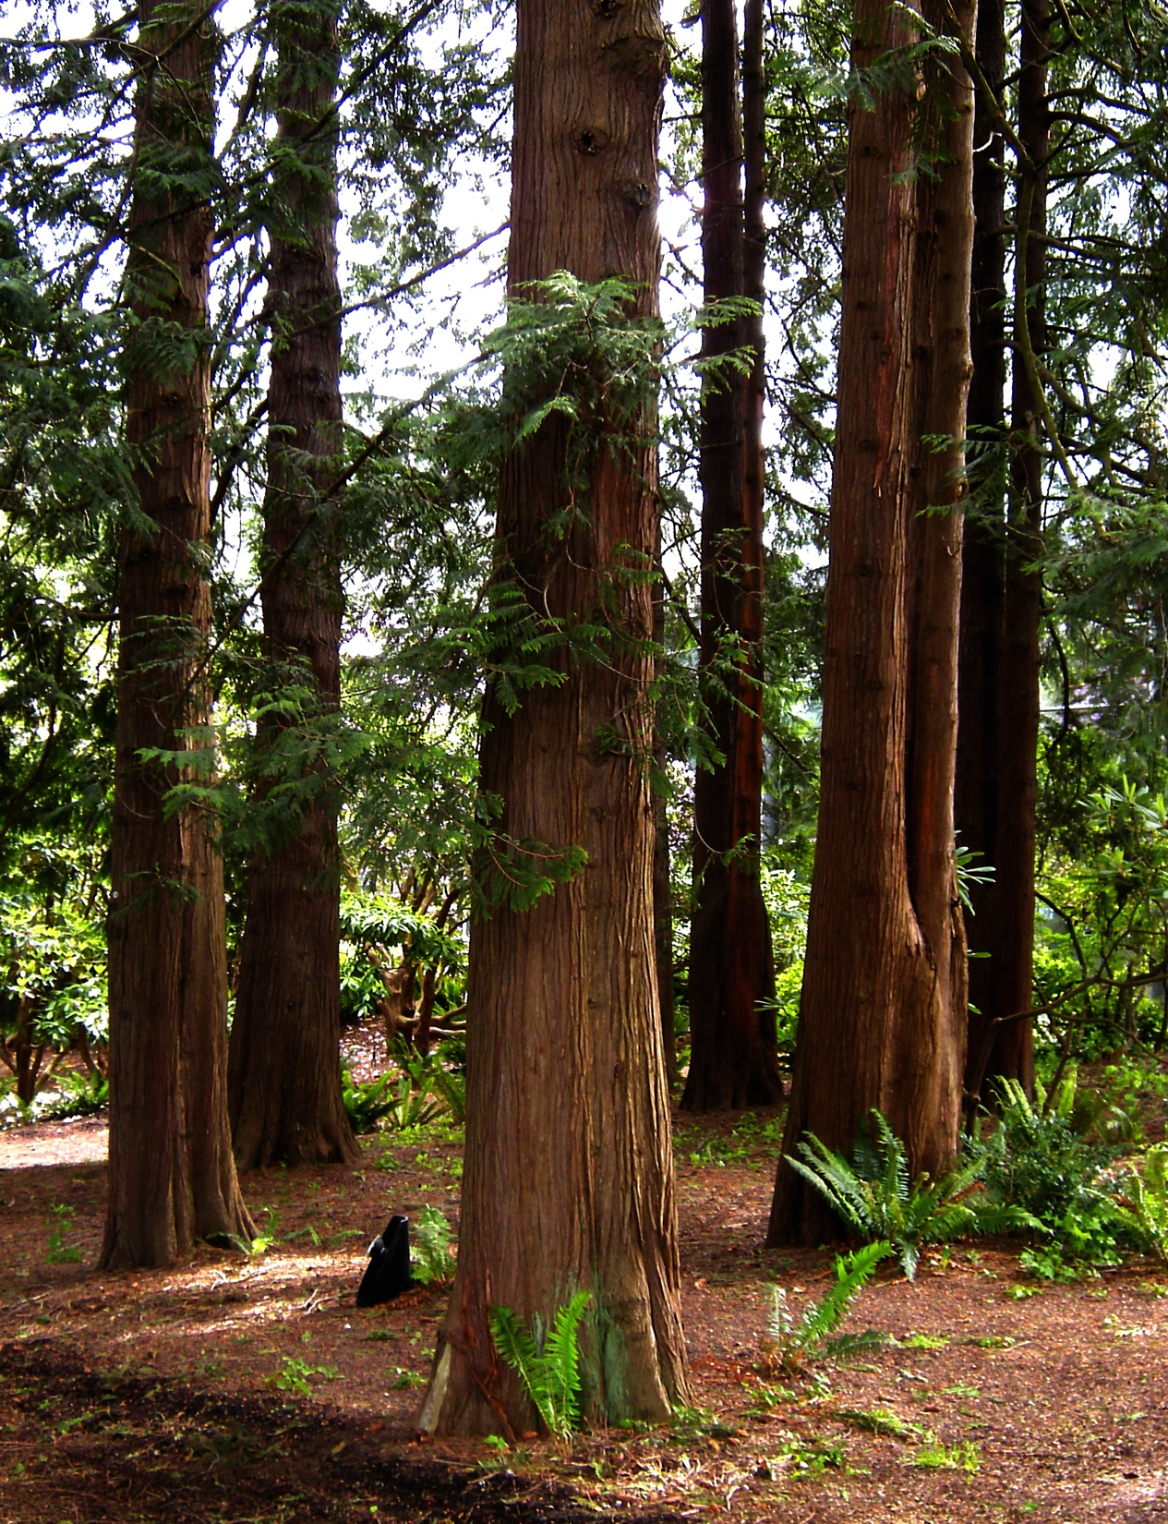
LO: Describe characteristics of forests of the PNW SLE: Apply mindful habits for academic success
Checkpoint Quiz on PNW Forests:
Why are alders important in the life cycle of forests in Washington?
How is the canopy in a Washington forest different from the canopy in a tropical rain forest?
Name two animal species native to the PNW.
Which tree species is shown in the picture at top right?
Which tree species is shown at bottom right?

Slide 61
Ecological Succession:
All environments change over long periods of time; this gradual change is called succession. Succession can be caused by:
Gradual or sudden changes in climate
Natural disasters (fire, volcanic eruption, etc.)
Disruptive activities by a single species (beavers, humans)

Slide 62
Types of Succession:
Primary succession: plants and animals move into an area where there have not been organisms living before. Early organisms in this type of succession are called pioneer species.
Secondary succession:
Plants and animals move into an area that is already inhabited by other organisms, and gradually replace them.

Slide 63
Homework:
LO: Describe cycles in natural environments.
SLE: Meet or exceed NGSS
Read p. 36-39
Review questions p. 42-43

Slide 64
LO: Make metric measurements SLE: Work collaboratively
Make the following measurements in metric units:
The length of your shoe
The distance between your seat and the nearest wall
Your height
The mass of your science notebook
The volume of a Dixie cup
6. The approximate volume of a golf ball
7. The area of one side of the classroom door
8. The temperature of the room
9. The mass of a pair of scissors
10. The perimeter of the top of your desk

Slide 65
LO: Design and carry out a scientific investigation SLE: Work collaboratively
Problem: Do heavy objects fall faster than lighter objects?
Hypothesis:
Independent variable:
Dependent variable:
3 Controls:
Procedure:
Data: (Quantitative, at least three trials)
Conclusion: (Five sentences)

Slide 66
LO: Design a scientific investigation. SLE: Work collaboratively.
Problem: Design the best way to launch a ping pong ball the greatest distance possible.
Hypothesis: What design will work the best? Why?
Procedure:
Data: (5 trials minimum)
Conclusion:

