Slide 1
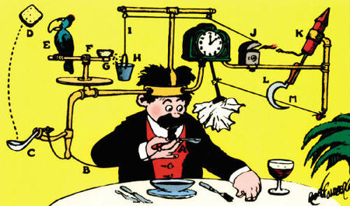
Energy, Simple Machines and Engineering Design Principles

Slide 2
Work and Energy:
Work: applying a force on an object over a distance.
For work to be done:
The object must move some distance.
The object and the force have to be going in the same direction.

Slide 3
Calculating Work
Work is calculated by multiplying force times distance:
W = fd
In the metric system, force is measured in
Joules: J
1 J = 1N * 1m
Joules are sometimes called Newton-Meters.

Slide 4
Power:
Power: power is the amount of work done in a certain period of time.
Power is calculated by dividing work by time:
P= w/t
In the metric system, power is calculated in watts, w:
1w = 1Joule/ second
10w = 10Joules/second

Slide 5
Energy and Work
Energy is usually defined as the ability to do work. This means that energy is also measured in Joules.
Example:
If you apply 3N to a box and move the box 10m, you’ve done 30J of work (3N * 10m = 30J)
To do this 30J of work, you’ve used 30J of energy.

Slide 6
Homework:
LO: Describe and calculate work, power and energy
SLE: Work independently
Read p. 94-99
Repond to the review questions on p. 99 (loose leaf, full heading, complete sentences, due on Tuesday)

Slide 7
LO: Calculate work and power SLE: Work cooperatively
Measure the work it takes to:
Lift your science notebook from the floor to your desk.
Drag a chair across the classroom.
Move your science book from one end of your desk to another.
Lift 1L of water from the floor to the seat of your chair.
Then find out how much power it takes to do each of these tasks in 5 and 10 seconds.

Slide 8
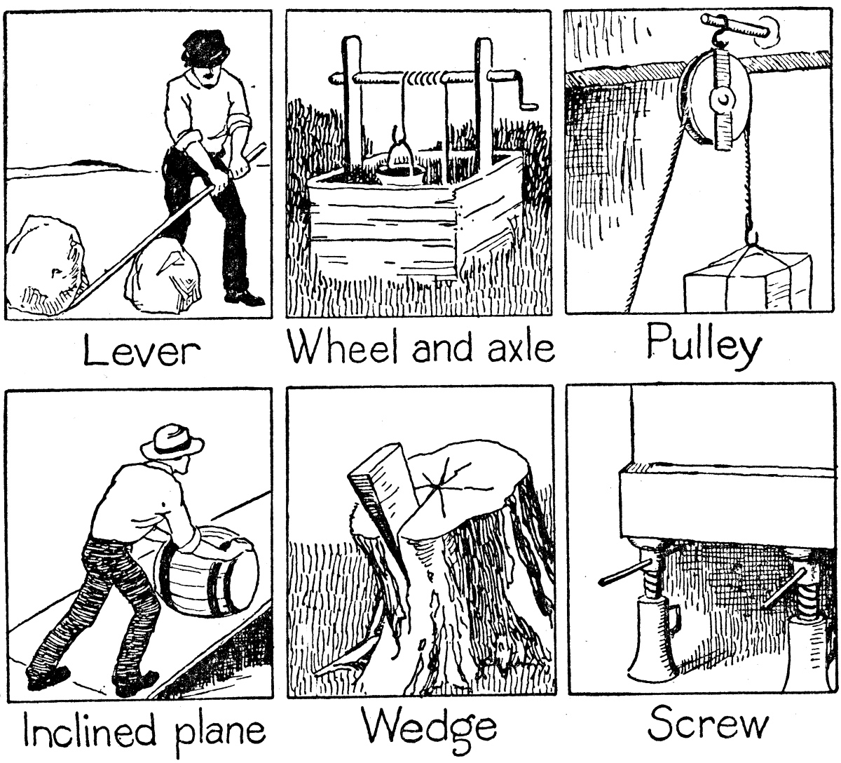
Simple Machines:
Machine: A device that makes work “easier” by reducing the force or distance required to do the work.
Machines do not reduce the total amount of work done; they can reduce the amount of force, or the distance, but not both at once.

Slide 9
How machines make work easier:
Using machines involves a trade-off.
Machines can do one of these two things:
They reduce the force that you need to apply to do the work (but you’ll need to cover a greater distance to do this).
They reduce the distance you have to travel (but you’ll need to apply a greater force to be able to do this).
No machine can increase the force and reduce the distance at the same time.

Slide 10
Work Input vs. Work Output:
Work input: the amount of work done by the person using the machine.
Work output: the amount of work done by the machine.
Work output can never exceed work input. (Work output is usually less).

Slide 11
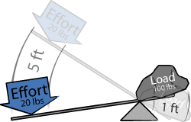
Mechanical Advantage:
Mechanical advantage: The number of times that a machine multiplies the force applied.
To calculate mechanical advtange, divide output force by input force:
MA = Ouput force
Input force

Slide 12
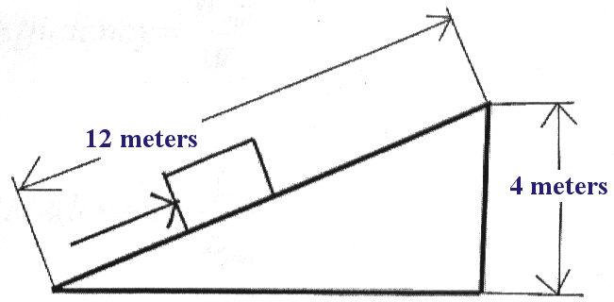
Mechanical Efficiency:
Efficiency: a comparison of the work that the machine puts out and the work that the person using the machine puts in:
Efficiency = work output
Work input

Slide 13
Types of simple machines:

Slide 14
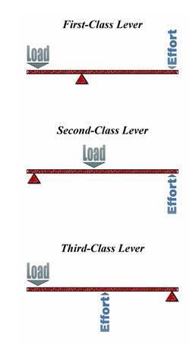
Types of levers:

Slide 15
Homework:
LO: Identify and describe types of simple machines
SLE: Meet or exceed NGSS
Read p. 106-112
Review questions p. 113

Slide 16
LO: Compare mechanical advantage of 1st and 2nd class levers. SLE: Work collaboratively
Problem: Does a 1st-class lever or a 2nd –class lever have the greatest mechanical advantage?
Hypothesis:
Independent variable:
Dependent variable:
3 Controls:
Procedure:
Make a first-class lever.
Place a 5-N weight at the end of the lever.
Using a spring scale, measure the amount of force needed to lift the weight using the 1st class lever.
Make a 2nd class lever.
Repeat steps 2 & 3 using the second class lever.
Compare the mechanical advantage of the two levers.
Data:
Type of lever | Output force (N) | Input force (N) | Mechanical advantage
1st class
2nd class
Conclusion:

Slide 17
LO: Compare the mechanical advantage of fixed and movable pulleys. SLE: Work collaboratively.
Problem: Does a movable pulley have a greater mechanical advantage than a fixed pulley?
Hypothesis:
Independent variable:
Dependent variable:
3 Controlled Variables:
Procedure:
Make a fixed pulley. (see left)
Use the pulley to lift a 5N weight.
Observe how much force you need to put into the pulley to lift the weight.
Repeat Steps 1-3 with a movable pulley.
Data:
1st class
2nd class
Type of Pulley: | Output Force (N): | Input Force (N) : | Mechanical Advantage:
Fixed:
Movable:
Conclusion:

Slide 18
Energy:
Energy: The ability to do work. Because observing the work being done is the only way to observe energy, Joules (J) are used to measure energy as well as work.
1J = 1N x 1m
Law of conservation of energy: in any closed system, the total amount of energy will remain the same (the energy can change form, though.)

Slide 19
Types of Energy:
Kinetic energy: the energy created by moving objects. Kinetic energy can be calculated by:
KE = mv²
2
The kinetic energy of moving objects can be increased by either increasing the mass or the velocity of the objects.

Slide 20
Potential energy: the energy an object has stored because of its position or chemical composition.
Gravitational potential energy is the energy that an object has stored because of its height above the ground; the higher it is, the more energy it will have as it falls.
Gravitational potential energy is calculated using this formula:
GPE (J) =
weight(N) x height (m)

Slide 21
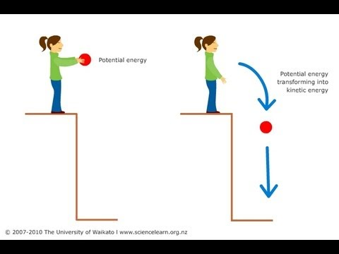
The total mechanical energy of an object is the sum of its potential and kinetic energy:
ME = GPE + KE
Since the total amount of energy cannot change, as an object falls, the GPE gradually converts to KE.

Slide 22
Other Forms of Energy (These are all forms of kinetic or potential energy) :
Thermal energy: the kinetic energy of all the particles that make up a substance. The faster the particles are moving, the higher the temperature.
Chemical energy: The energy that is produced during chemical reactions.
Electrical energy: kinetic energy produced by moving electrons.
Sound energy: kinetic energy caused by vibrations in solids, liquids or gases.
Electromagnetic energy: energy produced by vibrations of subatomic particles (electrons → photons).

